Slide 1
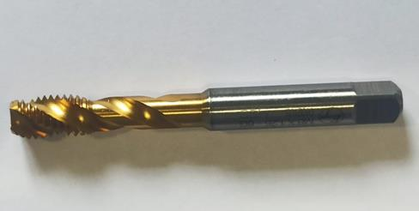
Countermeasure:- MACHINING STAGE
EVIDENSES
TAPPING MACHINE :-SE/TAP/01
BEFORE
AFTER
Round type TAP are being used in place of taper shank type tap as per requirement
Problem/Present Status:
Countermeasure:
Round type TAP are being used in place of taper shank type tap as per requirement and being monitored as per F/PROD/07.

