Slide 1
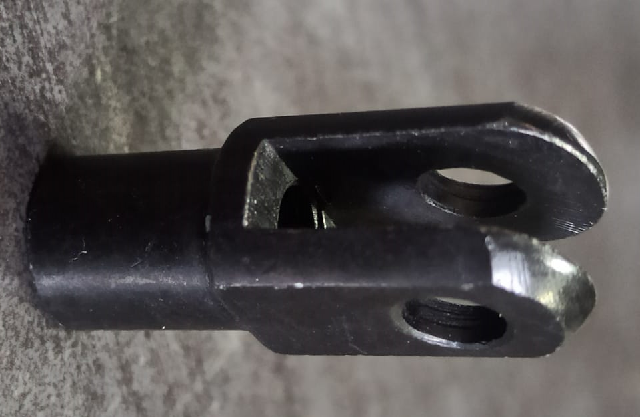
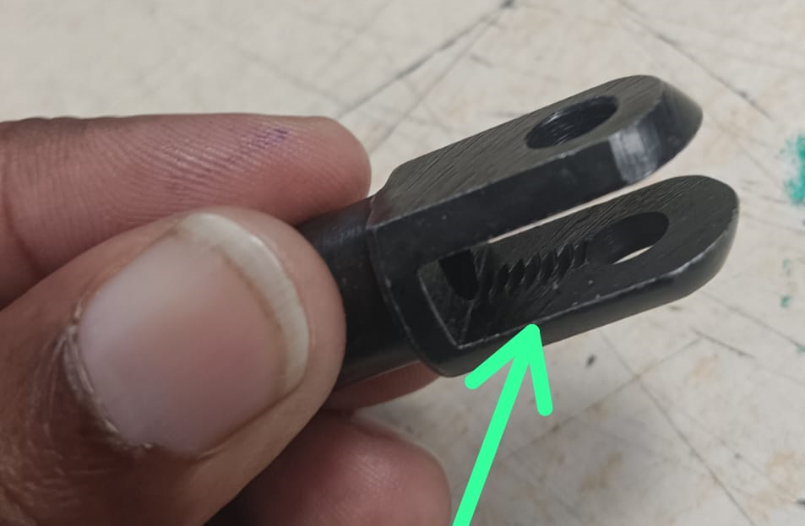
ONE POINT LESSON
Shop :- (SHARP ENGINEERS- A 31) |  | Dept. :- FINAL INSPECTION (SE/FI-01)
Class |  |  |  | Lesson no | 03
 |  |  |  | Date of preparation | 31/10/2023
 | Basic knowledge | Improvement class | Trouble shooting class | Leader | Mr. V. Jadhav
 |  |  |  | Section leader | Mr. Umesh Chotmal
Topic:- Excess thread length 13.0 min (PUSH ROD FORK FOR M/CYL 2WH,RE J1 (B2SG010260)
Key Points:- Thread 13.0 min should be as per drawing and single hole.
Know Why:- To supply defect free part at customer end.
OK
Not OK
Date | 31/10/2023
Teacher | Mrs. Vaishali Jadhav | Mr. Umesh Chotmal | Mr. Rahul Kasar
Learner | Mrs. Kalpana | Mrs. Urmila M.

