Slide 1
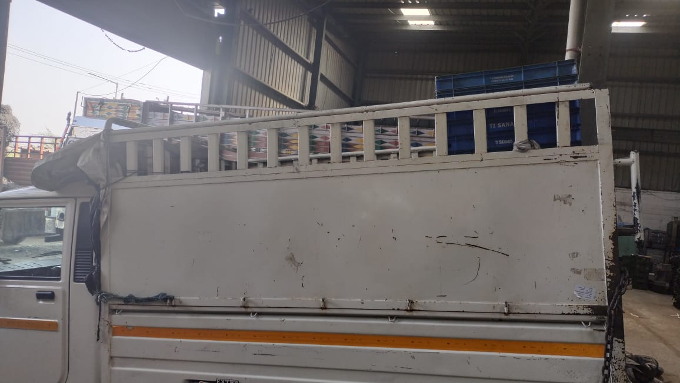
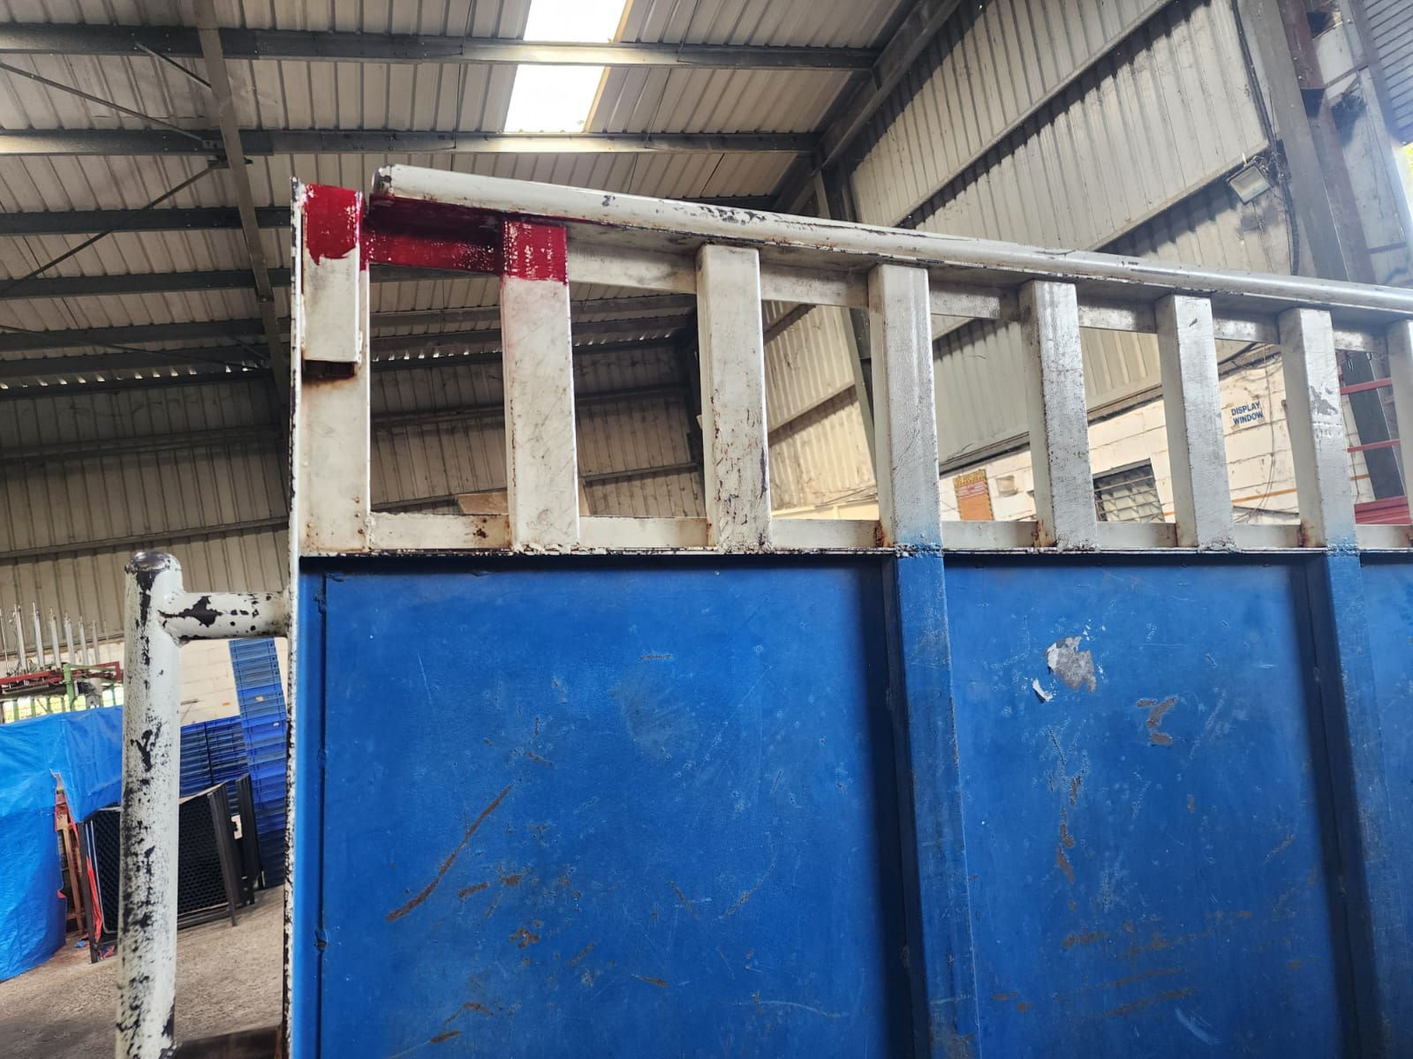
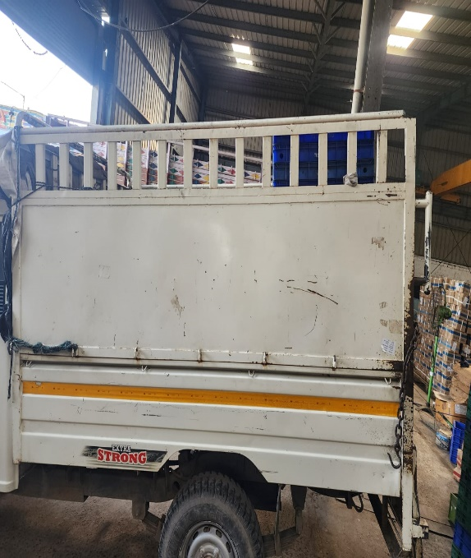
ACTION EVIDENCIES -Before & After
Before
After
Problem Definition:--
Over Stacking of bins in vehicle bins can falls in loading & unloading material cause dent & damage on Machining Area.
Improvement / Benefit :-
Stacking position define (Red color marking for maximum stacking of material )

Slide 2
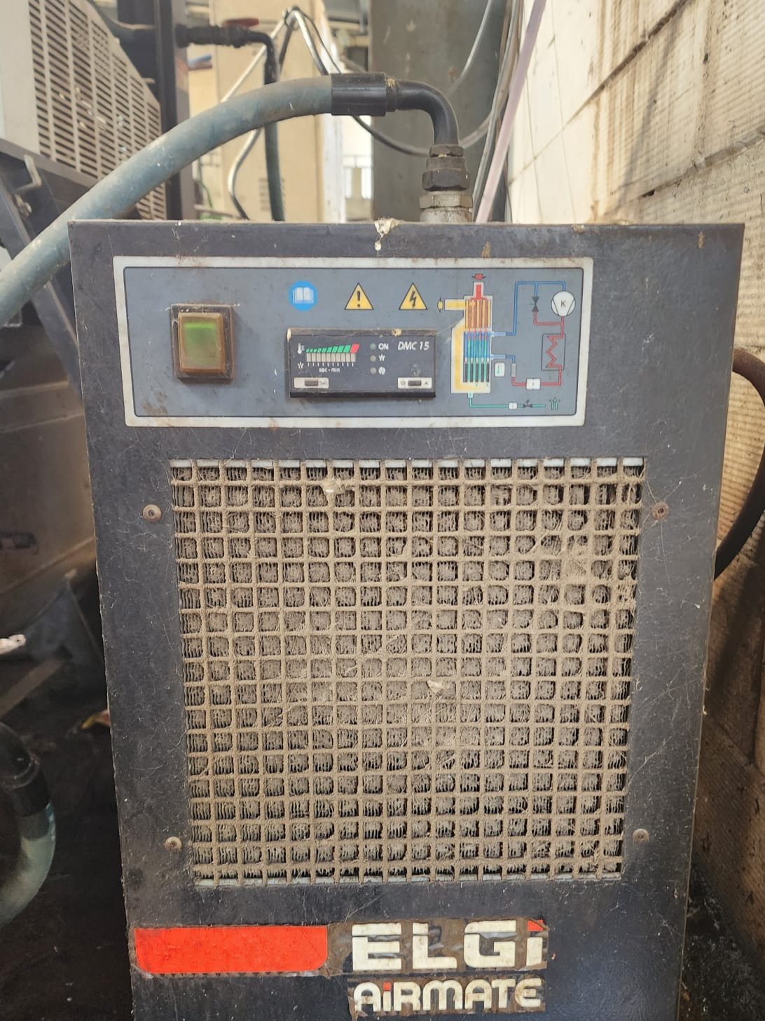
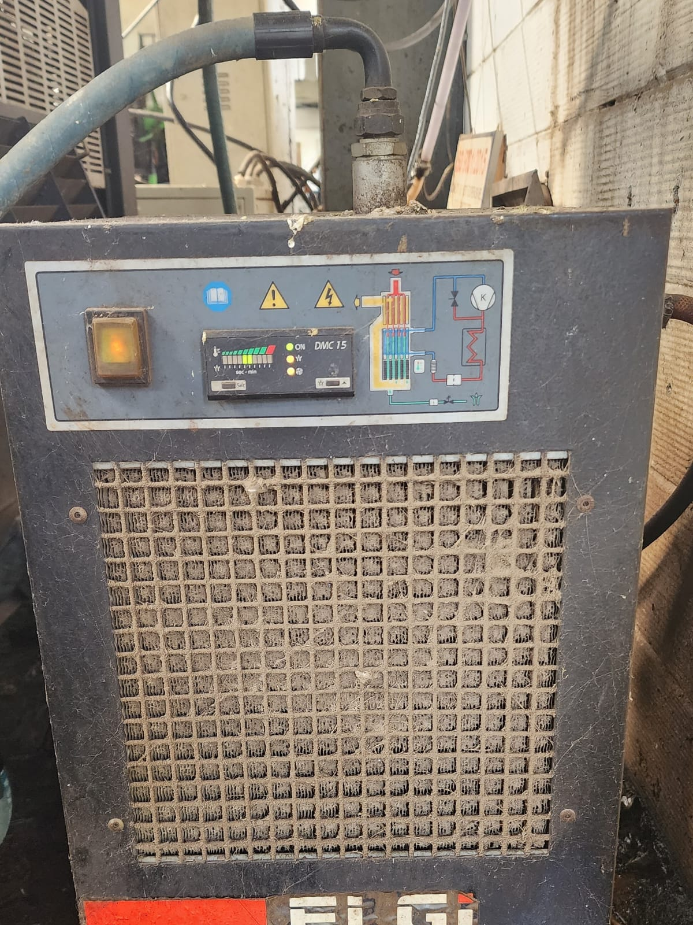
ACTION EVIDENCIES -Before & After
Before
After
Problem Definition:-
Water comes in contact through compressed air in cleaning Operation due to Air Dryer Not Working.
Improvement / Benefit :-
Compressor Air dryer repaired & in working condition .

Slide 3
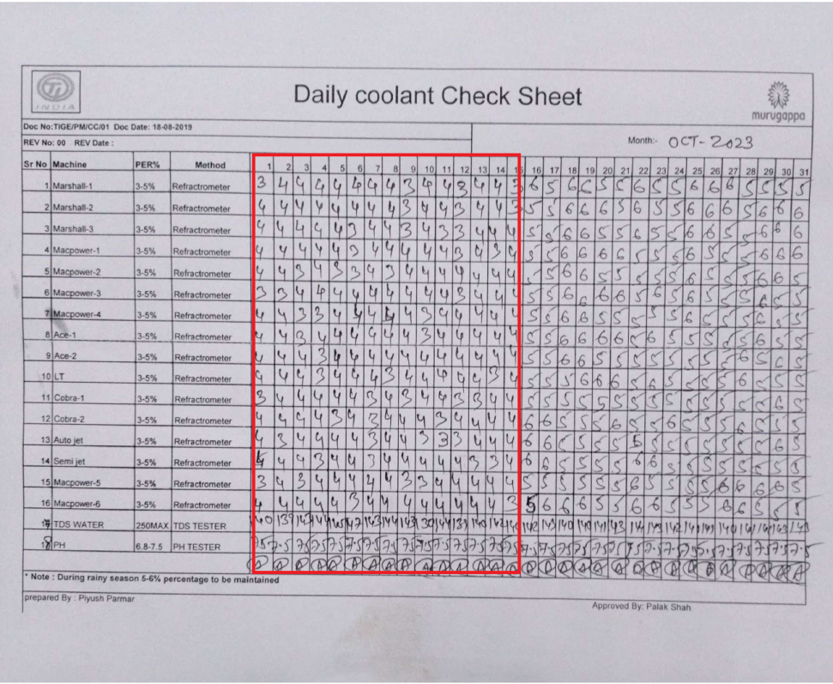
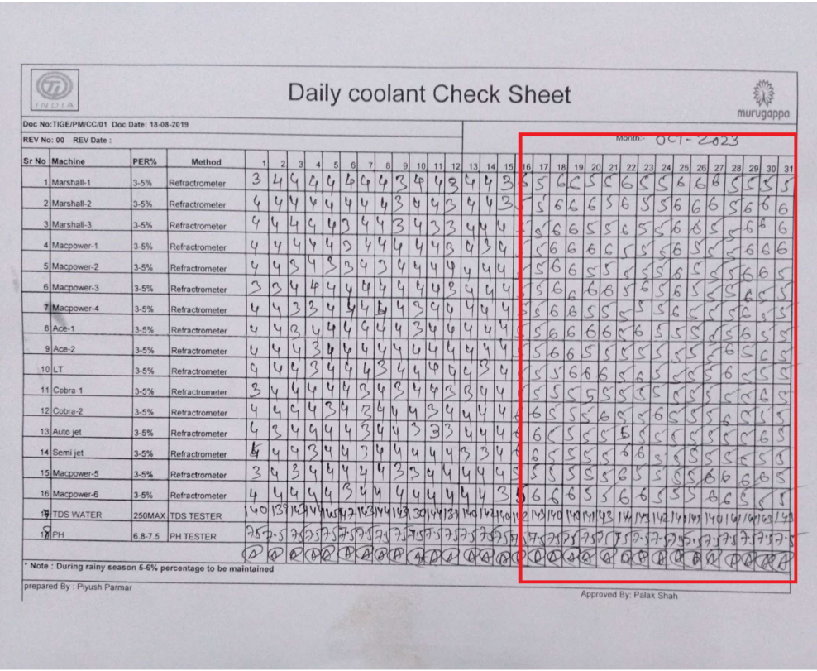
ACTION EVIDENCIES -Before & After
Before
After
Problem Definition:-
. due to Less coolant (3-4%)concentration used in CNC machine rust get formed on machined area
Improvement / Benefit :-
Coolant concentration increased to 5-6 % from 3 - 4%.

