Slide 1
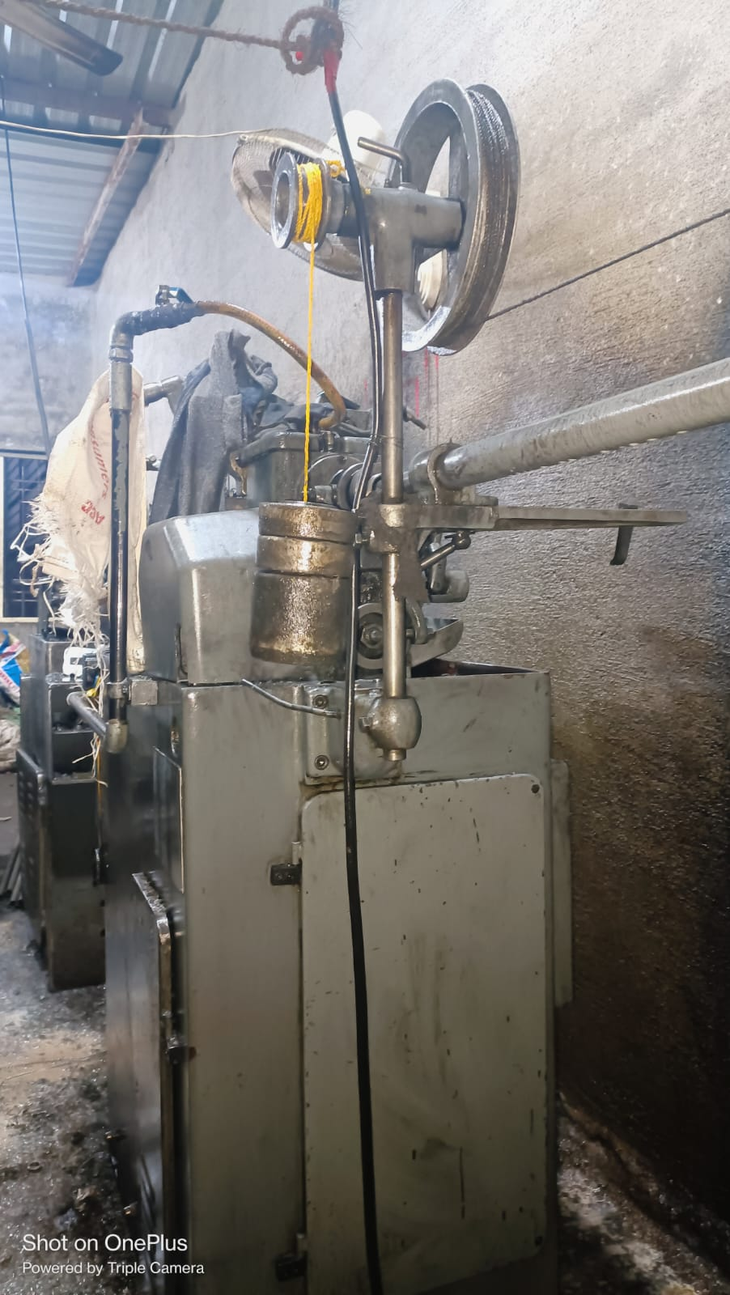
Occurance Side Corrective Action
After
On Traub Machine Balance Weight Increase By 2Kg

