Slide 1
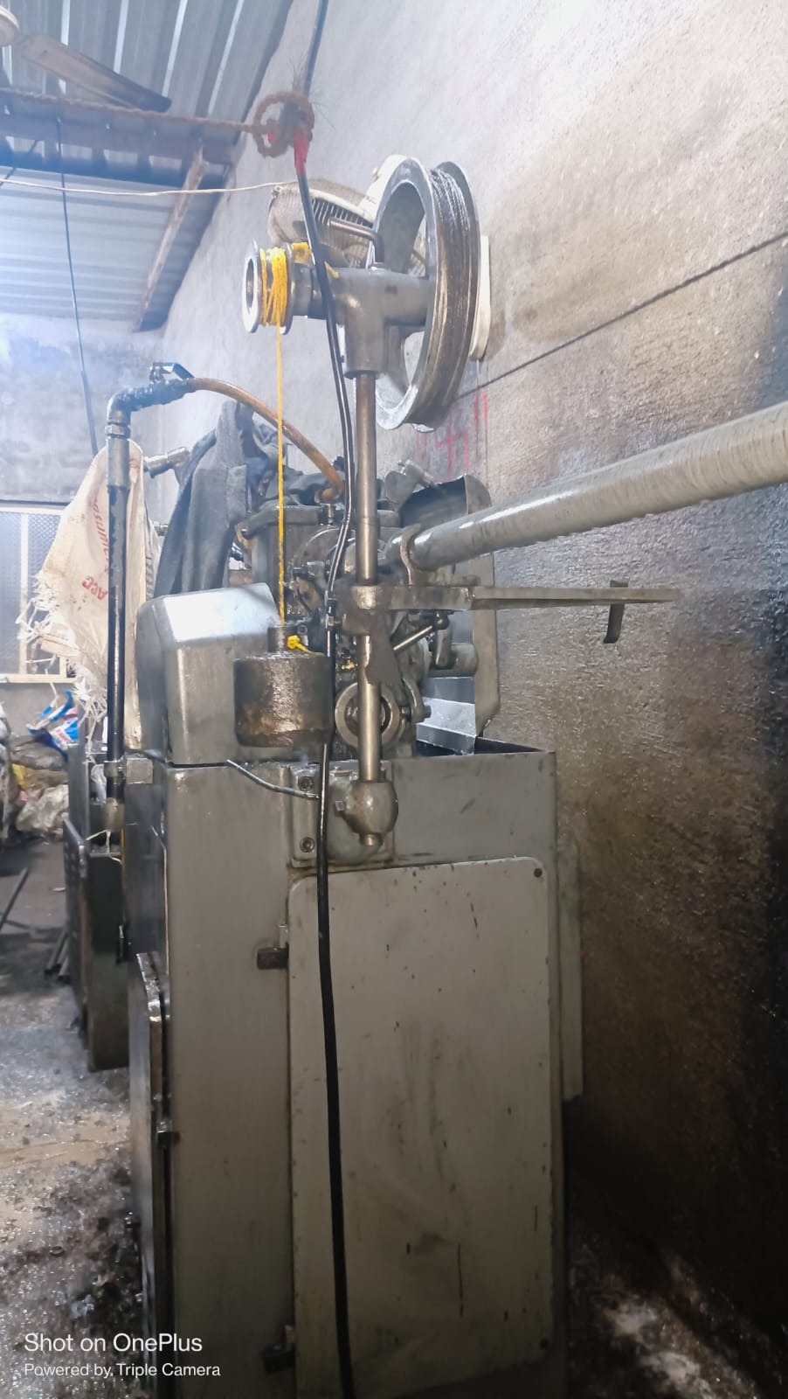
Occurance Side Corrective Action
Before
On Traub Machine Before Weight Loan was 6kg

