Slide 1
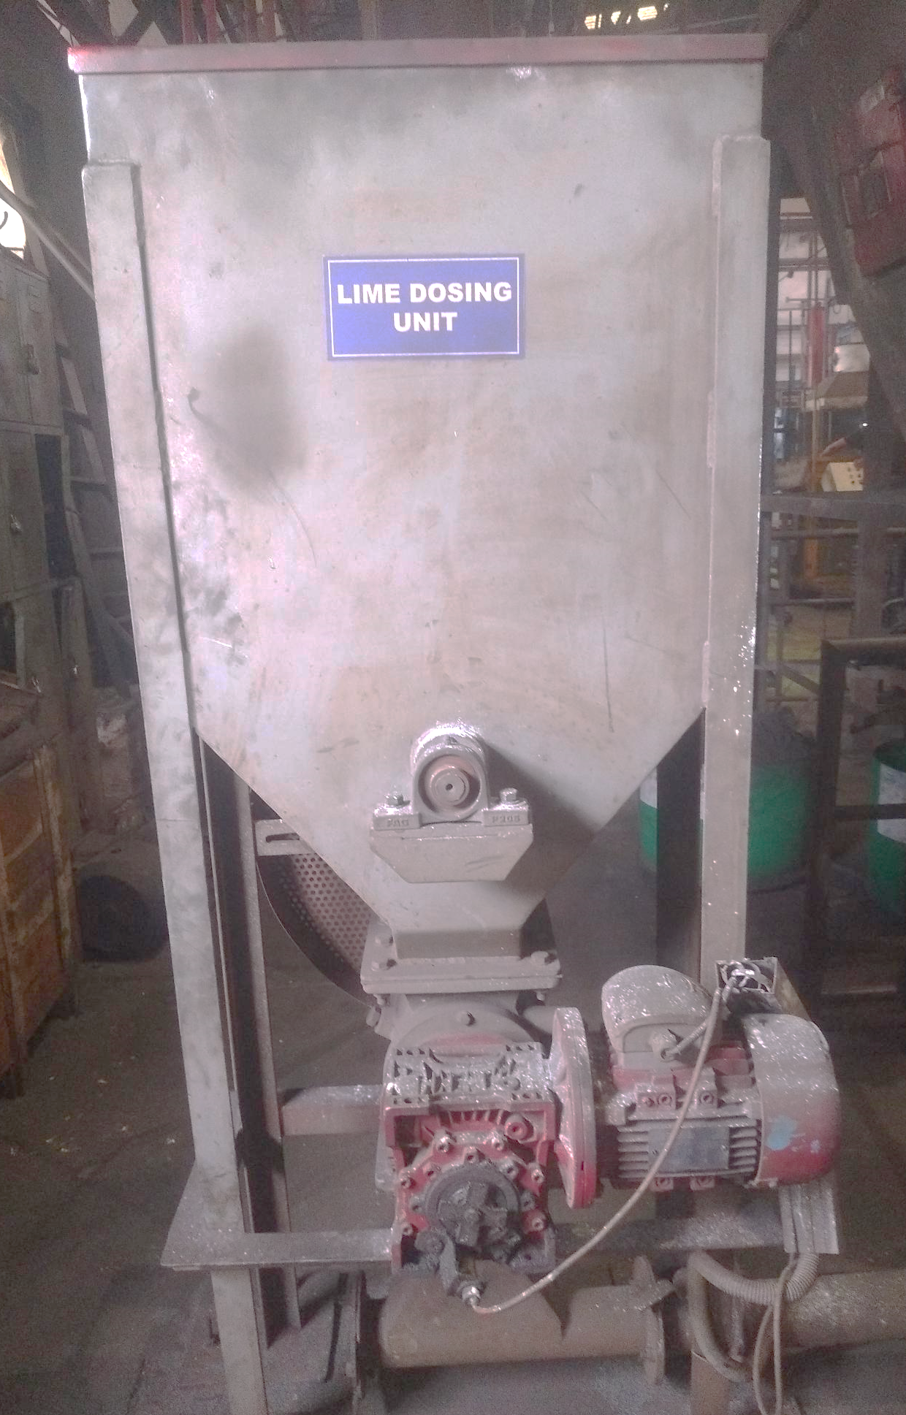
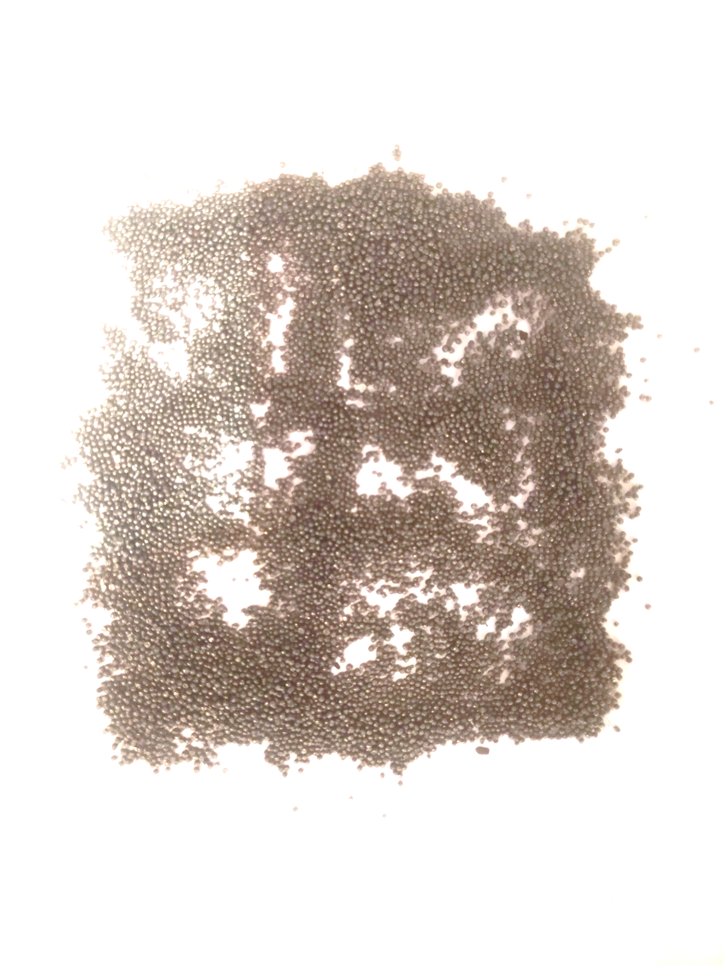
After
Lime powder dosing unit started
OK shots
after shots screening & lime powder dossing
Shots without moisture & Dust lime powder dosing started for absorbing moisture

