Slide 1
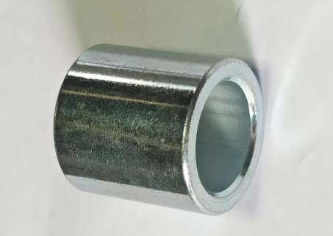
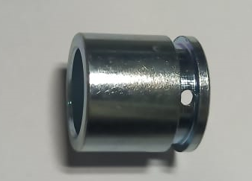
ONE POINT LESSON
Shop :- (SHARP ENGINEERS- A 31) |  | Dept. :- FINAL INSPECTION (SE/FI-01)
Class |  |  |  | Lesson no | 05
 |  |  |  | Date of preparation | 06/12/2023
 | Basic knowledge | Improvement class | Trouble shooting class | Leader | Mr. V. Jadhav
 |  |  |  | Section leader | Mr. Umesh Chotmal
Topic:- MIX UP OTHER MODEL-WRONG PART (OIL LOCK COLLAR (HMC-31/K38G)
Key Points:- Component should be mix up and as per drawing/customer requirement.
Know Why:- To supply defect free part at customer end.
OK
Not OK
Date | 06/12/2023
Teacher | Mrs. Vaishali Jadhav | Mr. Umesh Chotmal | Mr. Rahul Kasar
Learner | Mrs. Kalpana | Mrs. Urmila M.

