Slide 1

Action Plan for Main Spring
Customer complaint : Main Spring XF1D1 model (Part No- F2GN15802B)- Main spring Total length oversize Required- 312.3 +4.0 Observed- 345.2 mm. Qty. – 303nos
Physical Phenomenon : Wrong Material Against Invoice
Part Name : Main Spring XF1D1
Part no. : F2GN15802B
Model : XF1D1

Slide 2

Main Spring – Wrong Material Against Invoice
 | Action Plan for Main Spring wrong Material Sent- Wrong Idnetification |  |  |  |  |  |  |  |  |  |  | Month :- Jan’24 |  |  | WK–01
Sl No | CR/CC | Date of complaints | Cell/ SC/ Othr Plant | Cust | IC | Complaint | Lot Qty | Defect Qty | NON DETECTION ROOT CAUSE FROM WHY- WHY | OCCURANCE ROOT CAUSE FROM WHY- WHY | Occurrence
 |  |  |  |  |  |  |  |  |  |  | CA | Poka Yoke Y/N |  | Status with EDC |  | Standardization & SOP/WI/ updation /) (Y/N)
 |  |  |  |  |  |  |  |  |  |  |  | Occ. | Det.
10 | CC | 03.01.2024 | ARGB | ETL | FFFS60229 | Wrong Material Against Invoice | 303 | 303 | W1. Dock Audit not Conducted | 1. Spring Store into FF Storage Rack 2. Packing person not changed Name of Identifications board 3. Dispatch person packed material as per Identifications | ICA : 100 % Segregation done available stock in dispatch & ETL end. | N | N | Completed |  | Yes
 |  |  |  |  |  |  |  |  |  |  | PCA : New Identifications board provided for Storage Rack During dispatch Dock Audit will be Carried | Y | N | 05.01.2024 |  | Yes

Slide 3
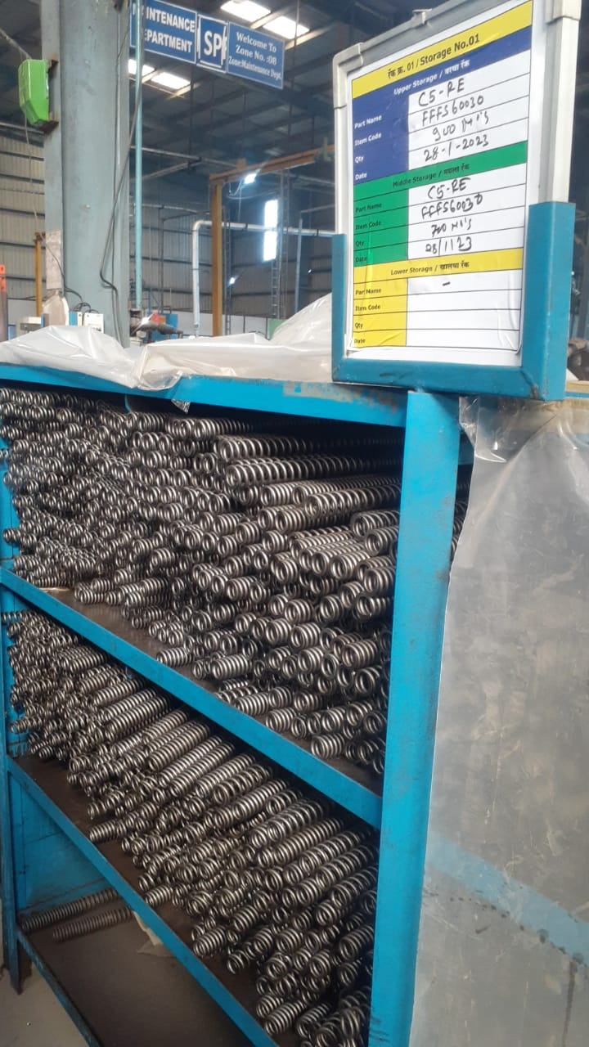
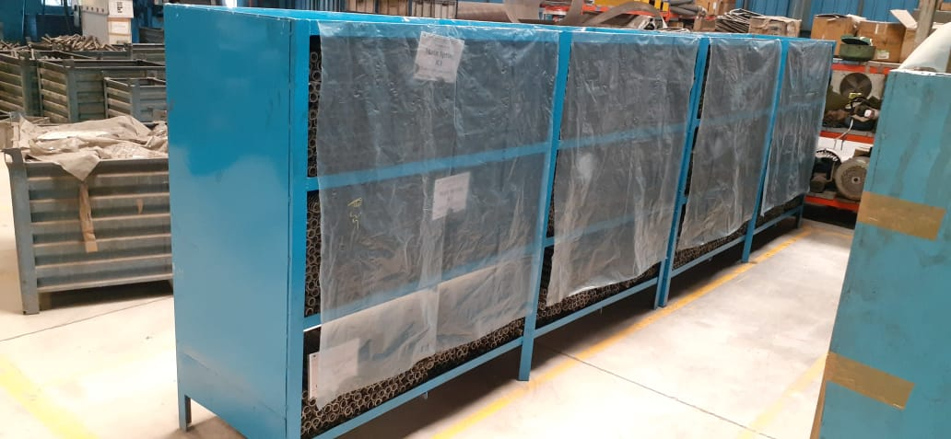
FF FG Srtorage
Before | After
Problem/Present Status: In Storage Identifications not changed | Now, Made FG Storage for this New rack and Made Identification on Display to avoid Mixup

Slide 4
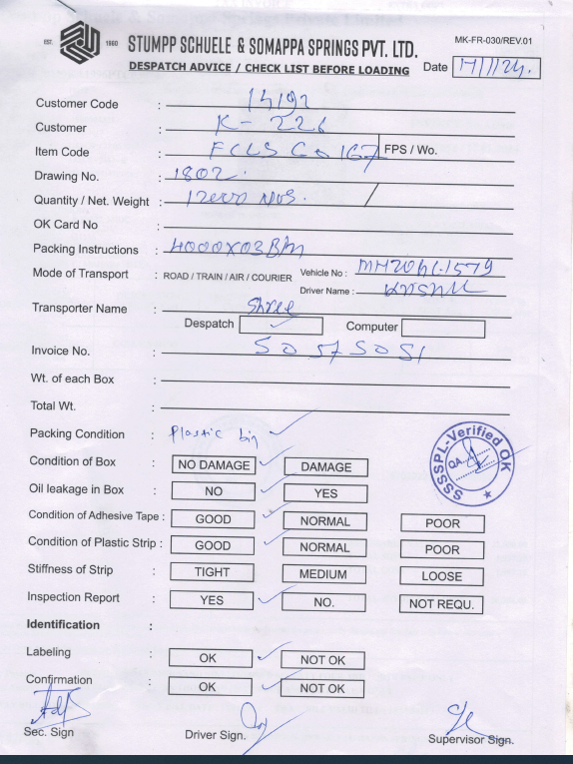
Dock Audit
During Dispatch Dock Audit cum Loading Slip Will be verified by QA

Slide 5
Thank You

