Slide 1
QSR Issues – Corrective actions
Part name & Part no. K2 – Caliper Body Model- Customer complaint :Dent , Damage
Physical Phenomenon : Casting Surface Handling Damage
Part Snap

Slide 2
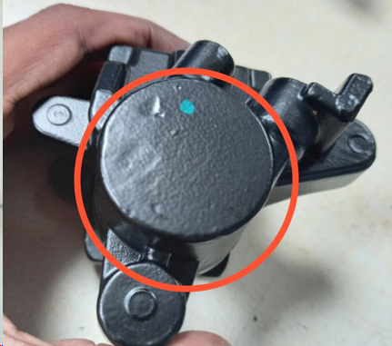
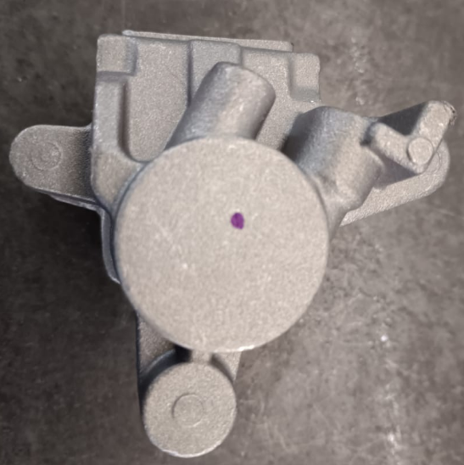
Corrective Action Details
Before
After
Dent and damage observed
Free from damage at casting surface
Part Name | Model | Vendor | Defect | Actions | T. Date | Status
K2 – Caliper Body |  |  | Customer complaint –Dent and damage observed Physical Phenomenon – Handling damage Why 1: Handling damage after post production. Why 2: Casting not arranged in properly. Why 3: Partition not available for casting kept between one to another. Why 4: Dedicated Pallet not designed for caliper body. Root Cause: Dedicated pallet not available | Containment Action :- .ETL End – Qty rejected by ETL Inspection side action Supplier End:- 1.Identification mark “Dot” Provided at bottom of the casting. 2.Quality alert Displayed. 3.ETL Visual standard displayed at final inspection and Master sample provided Inspection side action ETL End:- 1- Q Alert displayed Cause Side Action:- Dedicated pallet designed for caliper body. Same trolley used from starting of production to till Final inspection. Dedicated manpower deployed in final inspection. |  | Completed Completed Completed Completed Completed Completed Completed Completed Completed
HORIZONTAL DEPLOYMENT : K11 caliper body
SUSTENANCE (PREVENTIVE) ACTIONS: Tree trolley implemented for post production

Slide 3
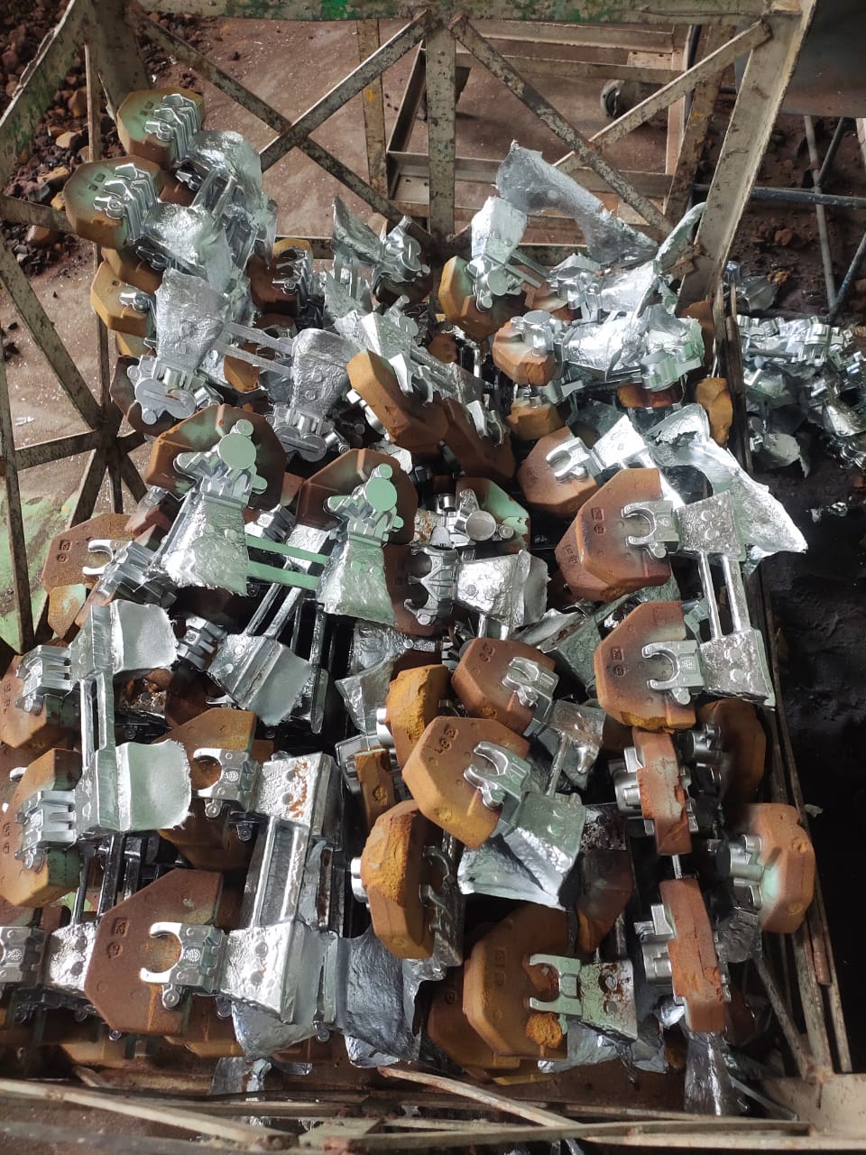
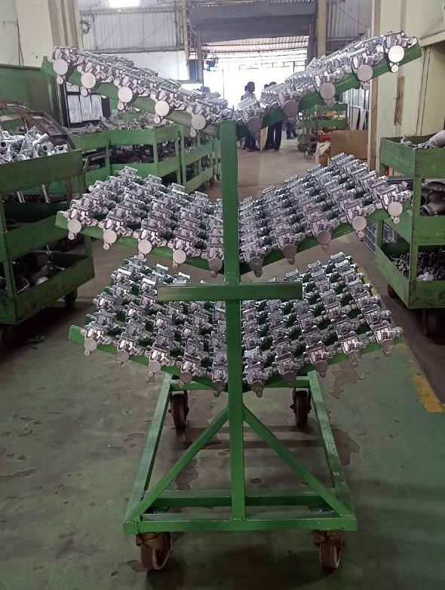
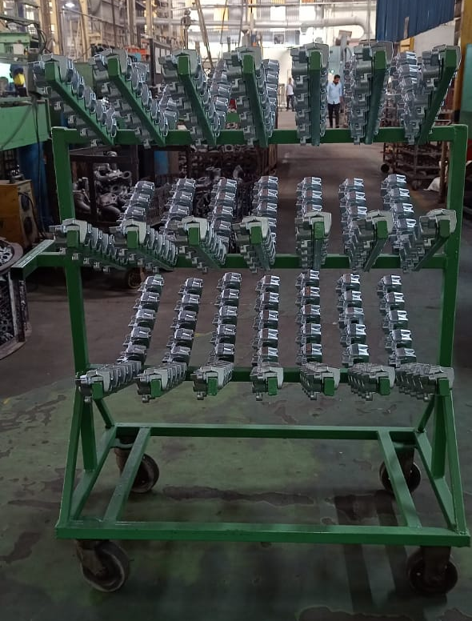
Corrective Action Details
2
BEFORE
AFTER
Castings are kept in open type metal pallet box and not arranged properly due to partition not available for one castings to another.
Tree type trolley designed for caliper body for during a production and post production process to avoid dent and damage issues.

