Slide 1
Action plan Dt.: 21 Jan 2024
Occurrence side

Slide 2
CONDITIONS FOR OCCURRENCE
● Phenomenon: Total length O/s
Trouble content
・Supplier: Saptagiri Engineering
・Model: KOLA
・Parts name: Inner Tube
・Part No.: S1GD01726O
・Date of Occurrence: 19. 01.2024
・Qty NG: 151 Nos.
NG Part | OK Part
Observed in Specification
Specification: 173.3 ±0.2 mm
Observed oversize than
Specification: 173.3 ±0.2 mm
●Parts Stock check results
Action
Area | Total Stock | Checked | Checking Method | NG Qty | Status
SEPL | 2500 | 2500 | Special gauge/ Height gauge | 15 | All available stock qty. Verified and Rework

Slide 3
UNDERSTANDING OF ACTUAL CONDITION AND CONTROL
Process Flow
Possible defect occurrence area.
RM Receipt Inspection
Cutting
Chamfer at both end
Straightness inspection
Packing
Dispatch

Slide 4
UNDERSTANDING OF ACTUAL CONDITION
● Understanding the actual cause – (Factor analysis)
Man
Machine
Stopper locking loosed while tube cutting
Inspector not aware about total length
End piece mix up with OK material
Set up part mix up with OK material
Wrong Set Up
Total length O/s
Observed against
Specification: 173.3 ±0.2 mm
Total length checking special gauge ware out
Length checking not done adequately
Method
Material

Slide 5
FACTS VERIFICATION
# | 4M | PROBABLE CAUSES | FACTS VERIFICATION | Jud.
1 | MAN | Inspector not aware about total length | Operator and inspector nor a aware about the total length special gauge and its operating | O
 |  | Wrong Set Up | While model change, Setting done by operator instead of Supervisor | ❒
2 | MACHINE | Set up part mix up with OK material | Red bin with lock and key it’s missing at the machine | O
 |  | End piece mix up with OK material | For storing end pieces one gunny bag available with identified | O
 |  | Stopper locking loosed while tube cutting | Not loosed the stopper while tube cutting | O
3 | METHOD | Total length checking special gauge ware out | Gauge verified and observed Observed 173.80 mm ( Its’ a over size ) Specification: 173.3 ±0.2 mm | ❒
 |  | Length checking not done adequately | Length checking done adequality | O
4 | MATERIAL

Slide 6
ROOT CAUSE ESTABLISHMENT (WHY-WHY ANALYSIS)
● Root cause establishment (Why-Why Analysis)
 | WHY – 1 | WHY- 2 | WHY -3 | WHY-4 | Why-5 | Why-6
Occurrence | Total length O/s | Wrong Set Up | While model change, Setting done by operator instead of Supervisor
Outflow | Total length O/s | Gauge verified and observed Observed 173.80 mm ( Its’ a over size ) Specification: 173.3 ±0.2 mm | Total length checking special gauge ware out
Conclusion
While model change, Setting done by operator instead of Supervisor
Total length checking special gauge wear out length checking special gauge ware out

Slide 7
COUNTERMEASURES
 | Cause | Countermeasure | Tgt. Dt. | Status
Supplier End | <Occurrence > | 1) Provide Lock & key Rejection storage bin. 2) Awareness Training given to concern operator & Inspector 3) Make SOP for Tube Cutting operation & its verification 4) Provide the stopper slot on chamfer machine | 21-01-2024 21-01-2024 21-01-2024 21-01-2024 | Completed Completed Completed Completed
Supplier / ETL End | <Outflow> | 1) Started 100% inspection for length verification. 2) Verify Gauge Length. | 21-01-2024 21-01-2024 | Completed Completed

Slide 8
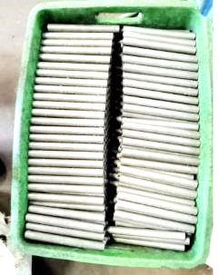
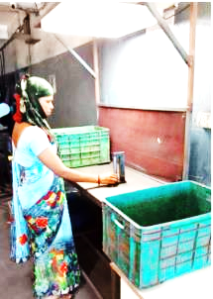
Countermeasure taken
Operation: Troube Machine
Target date: 21-01-2024
Uninspected material keep in to the bin with qty 250 nos | While inspection with input ( uninspected ) material and 100 % length verification, it is ok keep at out put ( finish good ) material
BEFORE
AFTER
Input material ( Uninspected)
Length gauge of size 173.3– 173.1mm
Uninspected material
Tube length 100 % Inspection
Out put ( Finished good ) material
.

Slide 9
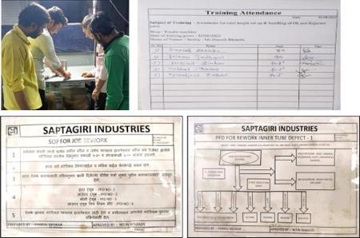
Countermeasure taken
Operation: Troube Machine
Target date: 21-01-2024
 | Made SOP of rejection for the tube length and other defects , Awareness training given to concern operator
BEFORE
AFTER
Awareness to inspector & operator
Training present member attendance
Not given training
Rejection & set up part handling SOP
.

Slide 10
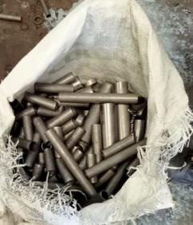
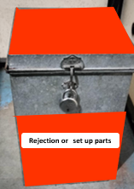
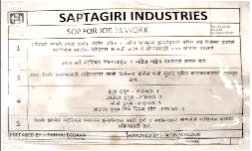
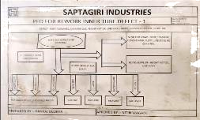
Countermeasure taken
Operation: Troube Machine
Target date: 21-01-2024
For rejection or set up storage used gunny bag. | Lock & Key bin provided at cutting machine for storing set up , & Rejected parts
BEFORE
AFTER
For rejection or set up storage used gunny bag.
Rejection or set up part storage with lock & Key
Rejection & set up part handling SOP
.

Slide 11
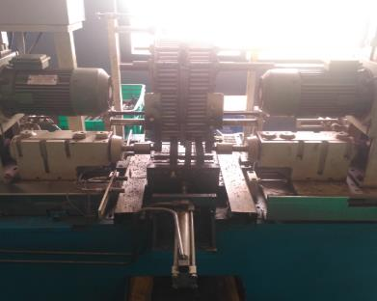
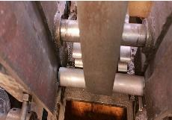
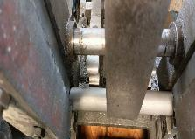
Countermeasure taken
Operation: Troube Machine
Target date: 21-01-2024
Provided stopper slot on chamfer machine to detect length short or length over size | Length over size tube will not enter Length short tube will drop at down the fixture & Gap in-between stoppers’ slot and tube
Gap in-between stoppers’ slot and tube
No Gap in-between stoppers’ slot and tube
Provided stopper slot on chamfer machine
.

Slide 12
Action plan Dt.:: 21.01.2024
Outflow side

Slide 13
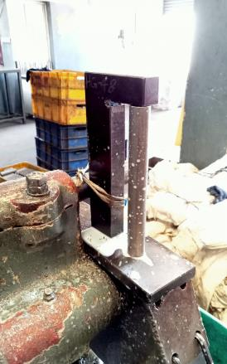
Countermeasure taken
Operation: Troube Machine
Target date: 21-01-2024
Inspection carry out at on machine by special gauge | 100 % inspection carry out at final inspection additionally by special length gauge
BEFORE
AFTER
Inspection carry out at on machine by special gauge
Length gauge of size 173.3– 173.1 mm
Tube length 100 % Inspection
.

Slide 14
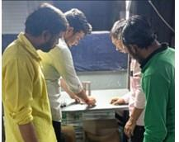
Countermeasure taken
Operation: Troube Machine
Target date: 21-01-2024
 | Made SOP of rejection for the tube length and other defects , Awareness training given to concern operator
BEFORE
AFTER
Awareness given to inspector & operator
Not given training
Training present member attendance
.

Slide 15
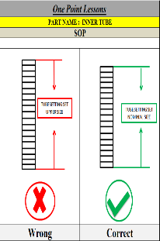
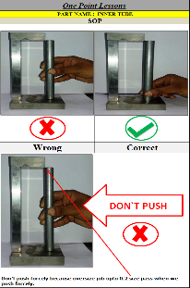
Countermeasure taken
Operation: Troube Machine
Target date: 21.01.2024
 | OPL Display at cutting & chamfering station
BEFORE
AFTER
Not display
.

Slide 16
THANK YOU

