Slide 1
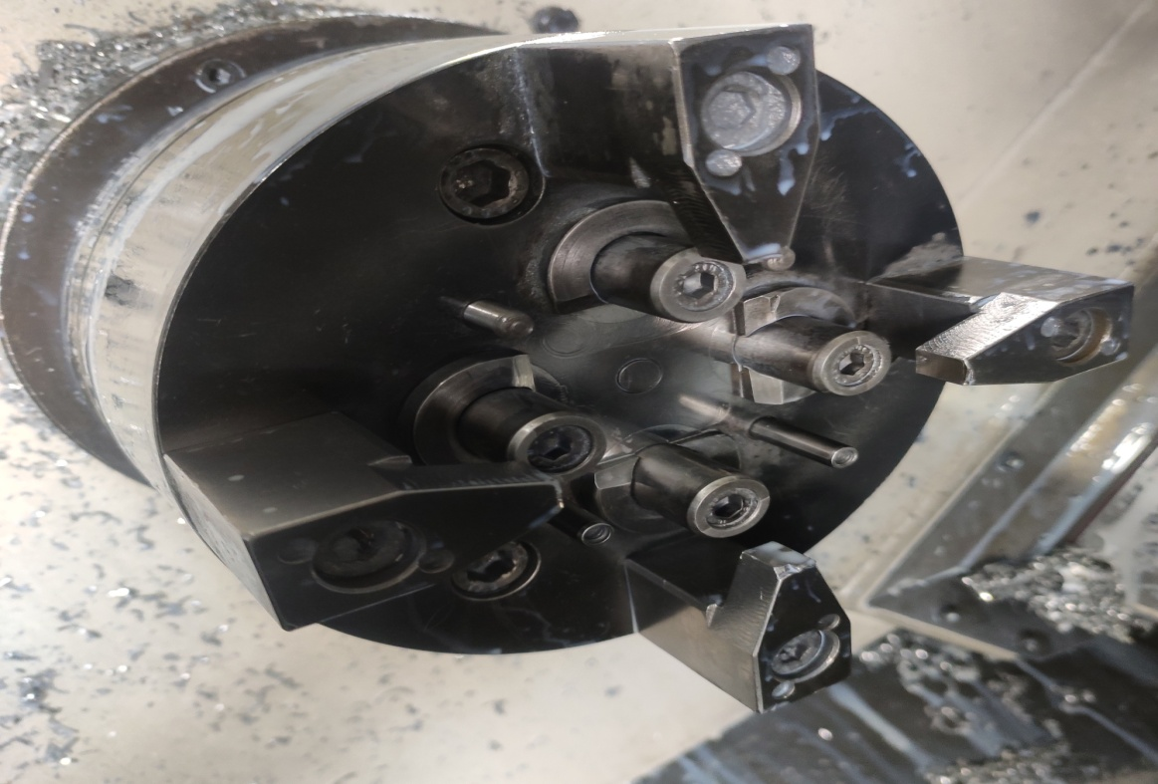
HOLDER – BM- Heavy Clamping Marks on parts.
Q-Alert
ADVANTECH ENGG.
M-24 - Waluj
AFTER
Parts Resting Pins.
Parts Guide Pins
Holder BM – Clamping Chuck only Four pins for Guide .
Prepared By : Mrs Prajakta
Approved By : Bappasaheb Gayake

