Slide 1
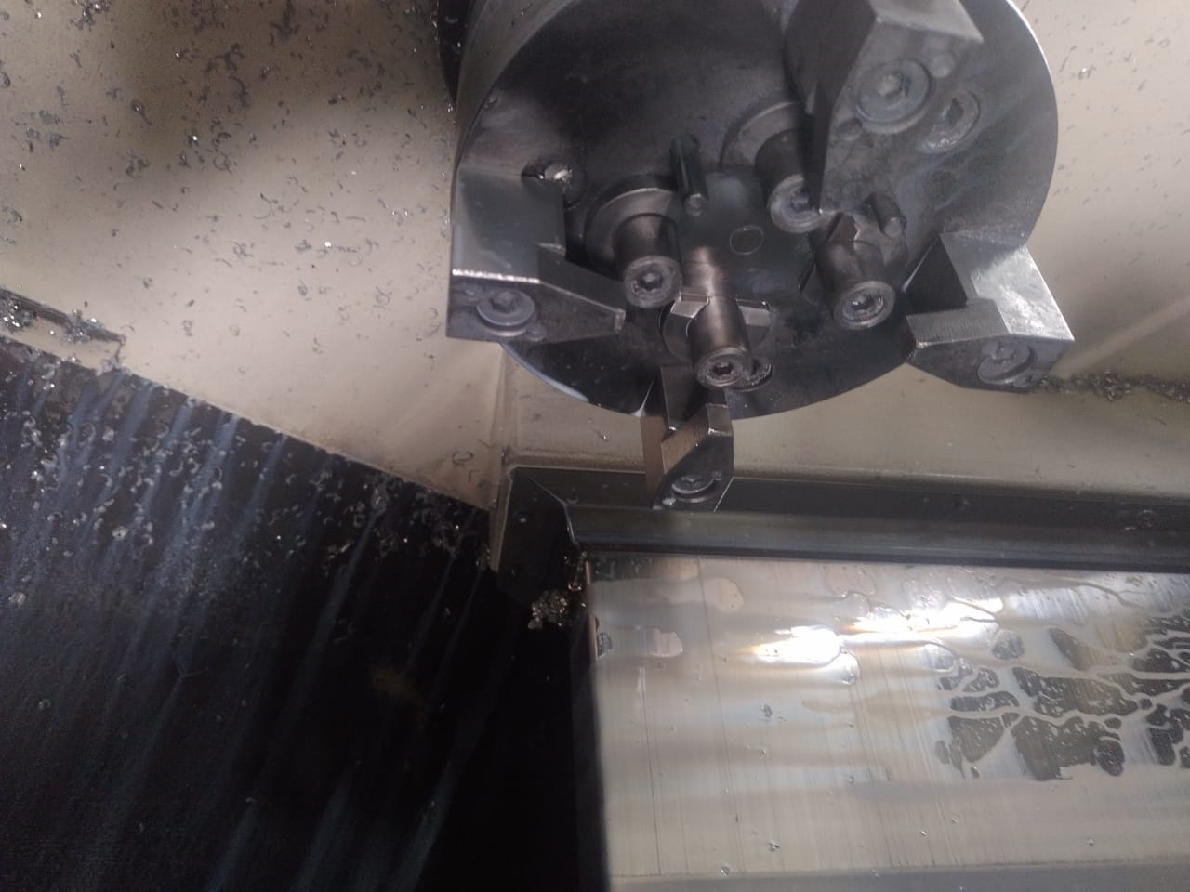
HOLDER – BM- Heavy Clamping Marks on parts.
Q-Alert
ADVANTECH ENGG.
M-24 - Waluj
BEFORE
Holder BM – Clamping Chuck only two pins for Guide Pins.
Prepared By : Mrs Prajakta
Approved By : Bappasaheb Gayake

