Slide 1
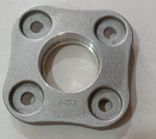
BM HOLDER CLAMPING MARK
Q-Alert
ADVANTECH
M—24 Waluj
Ok Part
NOT Ok Part
Not Available
Approved By : Bappasaheb Gayke
Prepared By : Prajakta Auti

