Slide 1
SHARP ENGINEERS(SHAKAMBHARI ENT.-UNIT-II)
ACTION PLAN FOR ID UNDERSIZE IN TAP COMPRESSION
(F2JV01202B)
Date : 28.01.2024
ETL Representative
Sharp engineers representative
Sr. | Name | Dept.
1 | Mr. Dipak Nale | IQA
2 | Mr. Pratik wani | PPC
3
Sr | Name | Dept.
1 | Mr. Pankaj Khadse | Plant Head
2 | Mr. Vinod bagul | HOD QA
3 | Mr. Nilesh Aage | NPD

Slide 2
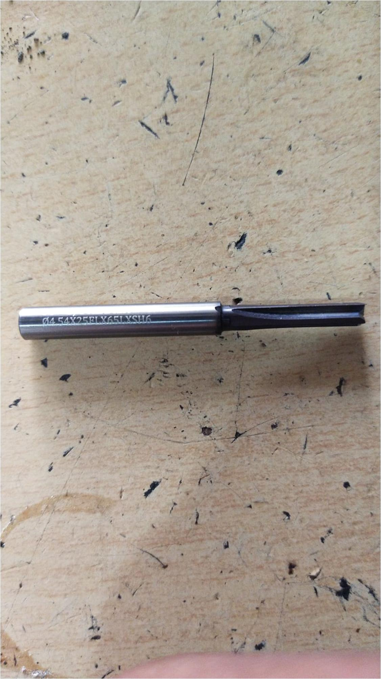
Check Point Ref : 01
TARGET DATE : 05.02.2024
STATUS : Pending
Before
After
New Reamer process completed to 5/02/2024.
4.5 (+0.02/+0.08) ID found undersize on end portion of 17.5 ± 0.15 depth.
Reamer size change 4.55/4.56 mm.

Slide 3
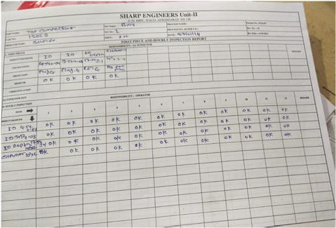
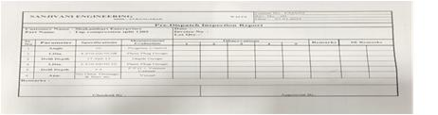
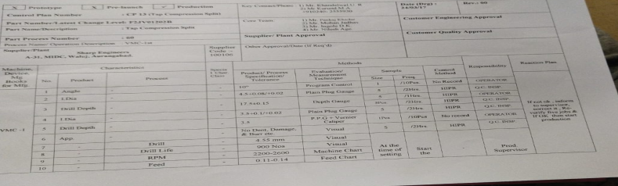
Check Point Ref : 02
TARGET DATE : 28.01.2024
STATUS : Closed
Before
After
First piece and hourly inspection report.
Reports not available on machine.
PDI Report.
Control plan
Set-up approval , first piece inspection, control plan reports not found at mfg. location of M/s Sanjivani Engg.
First Piece inspection report, Setup approval reports and control plan now available at Sanjivani engineering

Slide 4
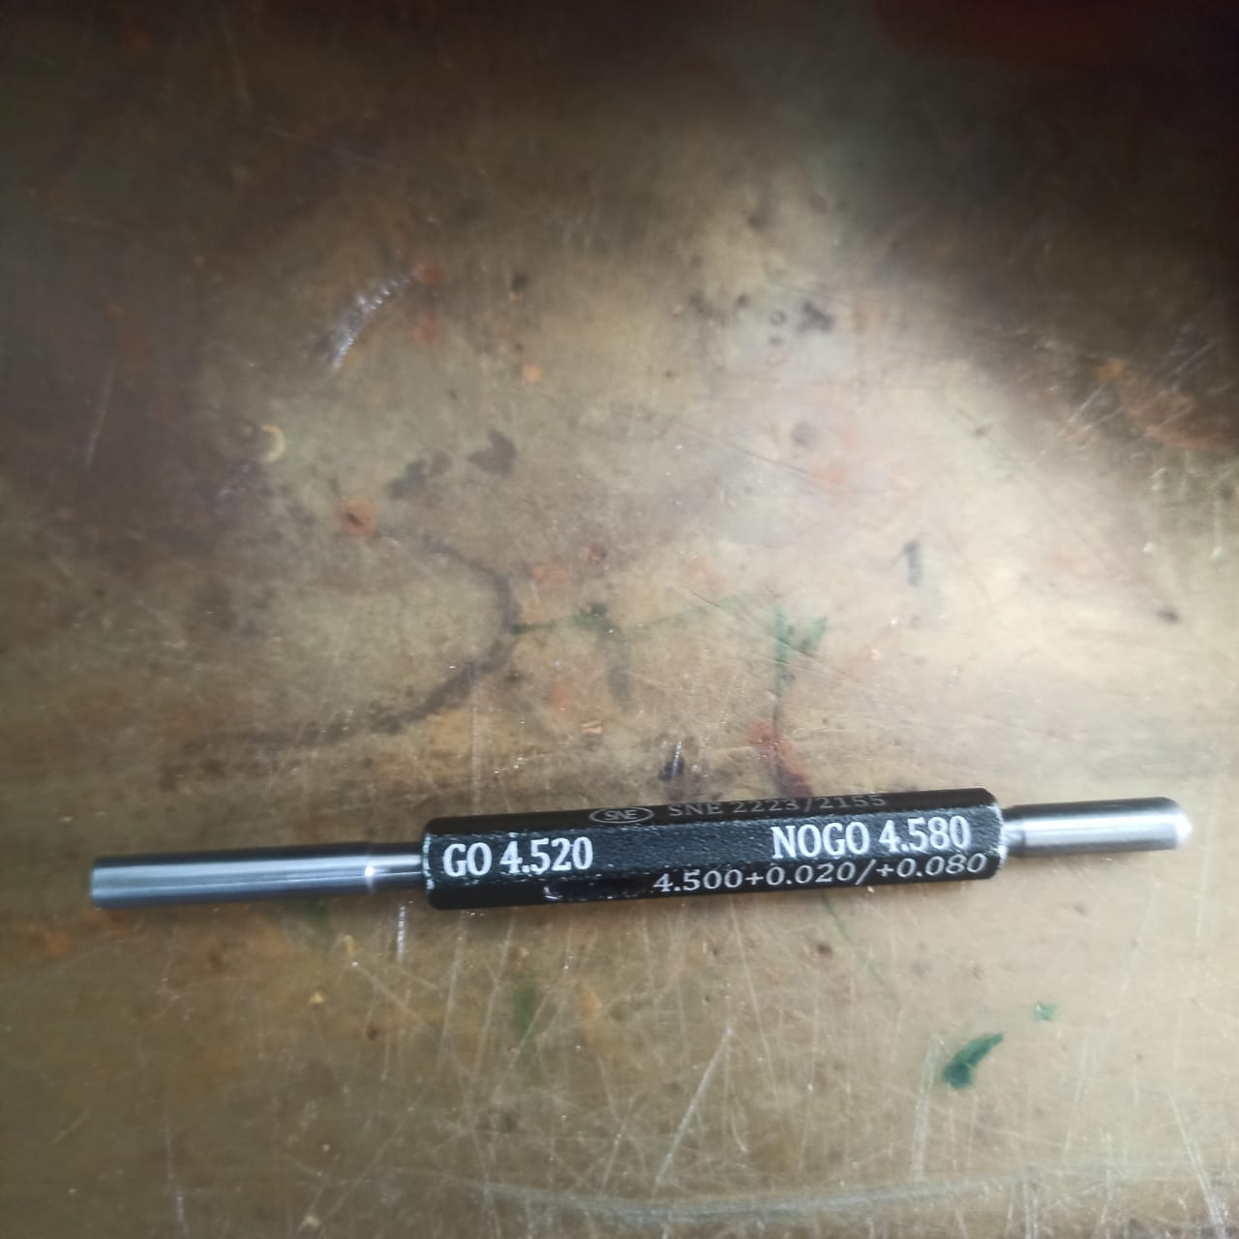
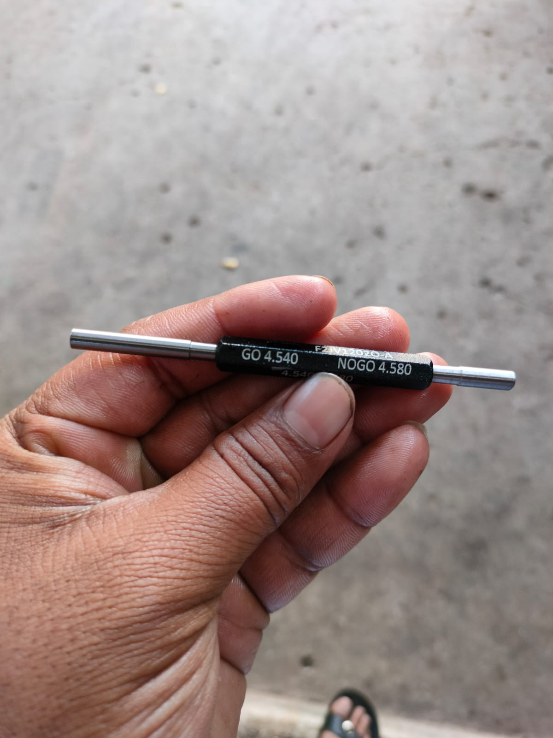
Check Point Ref : 03
TARGET DATE : 27.01.2024
STATUS : Pending
Before
After
Old plug gauge of size
Go- 4.520 mm and No go- 4.580 mm.
New plug gauge of size
Go- 4.540 mm and No go- 4.580 mm.
New Gauge meet me 30-01-2024
New plug gauge of size
Go- 2.750 mm and No go- 2.90 mm.
To be need of new gauge of ID checking
4.5 +0.02/+0.08
2.8 ± 0.1
New gauge made for
4.54 to 4.58 mm.
2.75 to 2.90 mm.

Slide 5
Check Point Ref : 04
TARGET DATE : 29.01.2024
STATUS : Pending
Before
After
To be need of correction in 3.5 mm drilling operation (3.5 standard pin stucking in hole).
Check feasibility of through hole drilling.

Slide 6
Check Point Ref : 05
TARGET DATE : 27.01.2024
STATUS : Closed
Before
After
Corrective lot submitted on 27.01.2024
Corrective lot submission date
Corrective lot of 165 NOS submitted on 27.01.2024

Slide 7

SHARP ENGINEERS(SHAKAMBHARI ENT.-UNIT-II)

