Slide 1

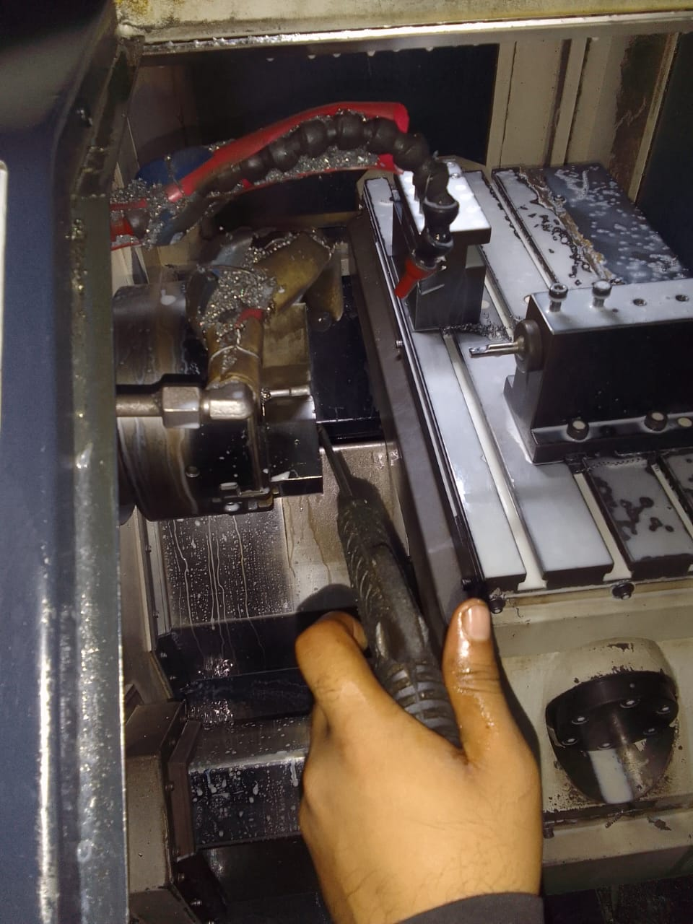
Occuranace Side Corrective Action
After
Air Flushing Arrangement on CNC Machine for 100% CNC Jaw Loose Burr Remove after Process Part Unload and then New Part Load for Machining Process.

