Slide 1
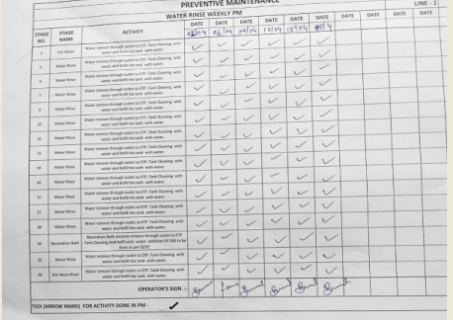
ACTION TAKEN - EVIDENCES
BEFORE
AFTER
We are doing weekly PM for water rinse
Now we have started Thrice week PM for Water rinse

