Slide 1
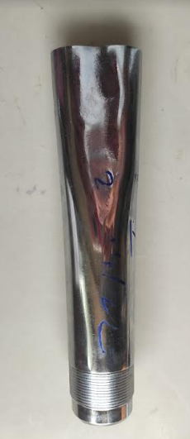
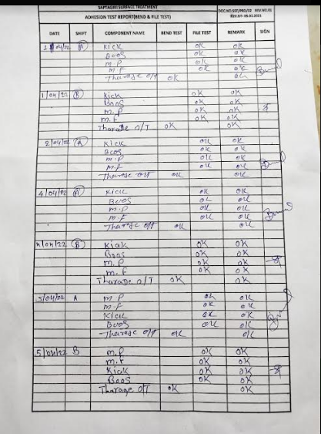
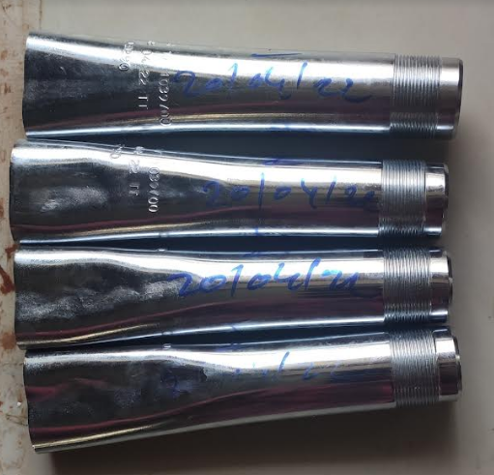
ACTION TAKEN - EVIDENCES
BEFORE
AFTER
Earlier we are doing 1 Nos sample Bend Test
Now we are starting 4 Nos sample bend test and record maintened

