Slide 1
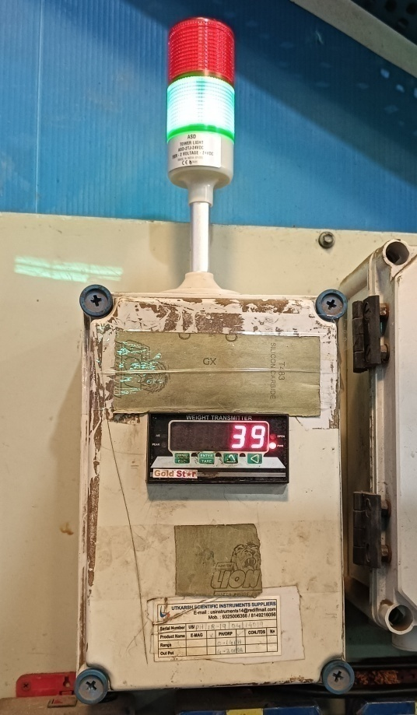
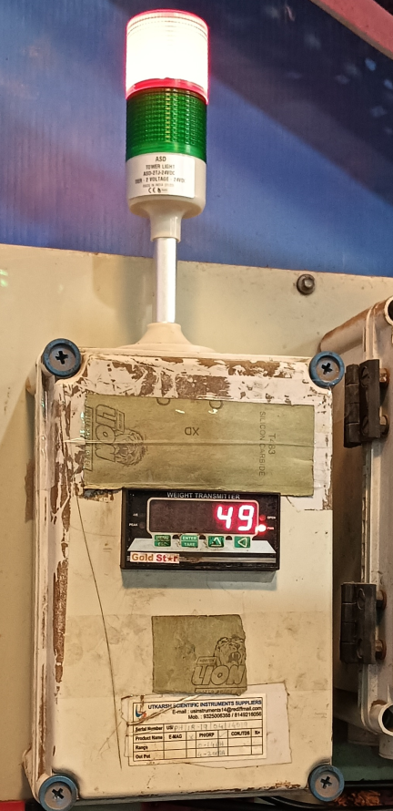
KRISHNA INDUSTRIES
Occurrence side Action After
Now Operator put the part directly into Barrel, If Weight is below 40 Kg then Green light will ON, hence no chance of Overloading
Now Operator put the part directly into Barrel, If Weight is above 40 Kg then Red light will ON & buzzer will ring, hence no chance of Overloading
2

