Slide 1
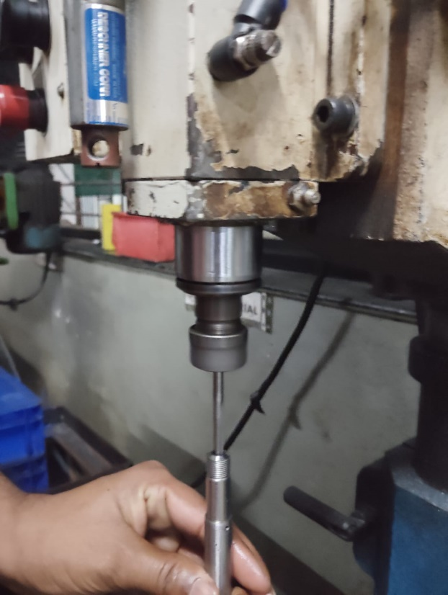
Occurrence Side Corrective Action
After
Deburring Machine Running condition

