Slide 1
Action plan for sand drop/Pin hole issue in CALIPER BODY-RAW FRONT REML J1C(B2BK04203O)
MAP ALLOYS

Slide 2
Action plan for sand drop/Pin hole issue in CALIPER BODY-RAW FRONT REML J1C
Why Why Analysis :
Why 1 : Sand drop and Pin holes at outer surface area
Why 2 : During die closing sand drop inside cavity .
Why 3 : Sand drop due to sand core rubbing from die cavity .
Why 4 :Due to die alignment not proper .
Why 5 :Due to Die pillar O.D and bush I.D wear out .
Root Cause : Die Pillar O.D and bush I.D wear out .

Slide 3
Action plan for sand drop/Pin hole issue in CALIPER BODY-RAW FRONT REML J1C
Action Plan :
Sr No | Defect | Action Plan | Resp | Target Date | Status
1 | Sand drops, Pin holes at outer surface area of casting . | Occurrence Side : 1.Die pillar and bush replaced . 2.Die pillar and bush checking points added in die PM check sheet. | 1 . Mr. Anil Dhande 2.Mr.R.Pandey | 1.20.04.2024 2.20.04.2024 | 1.Completed 2.Completed
2 |  | Detection Side : 1.Awarness given to concern person through meeting and QA alert . | Mr. R. Pandey | 8.04.2024 | Completed

Slide 4
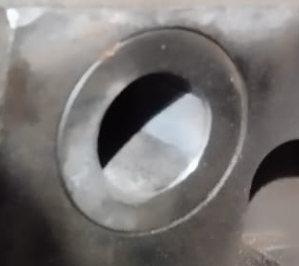
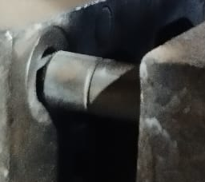
Action plan for sand drop/Pin hole issue in CALIPER BODY-RAW FRONT REML J1C
Action Plan :
BEFORE
AFTER
Not ok pillar and bush
OK pillar and bush

Slide 5
Thank You

