Slide 1
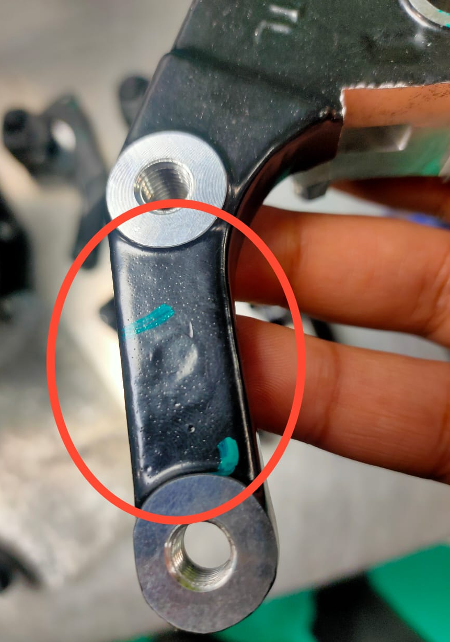
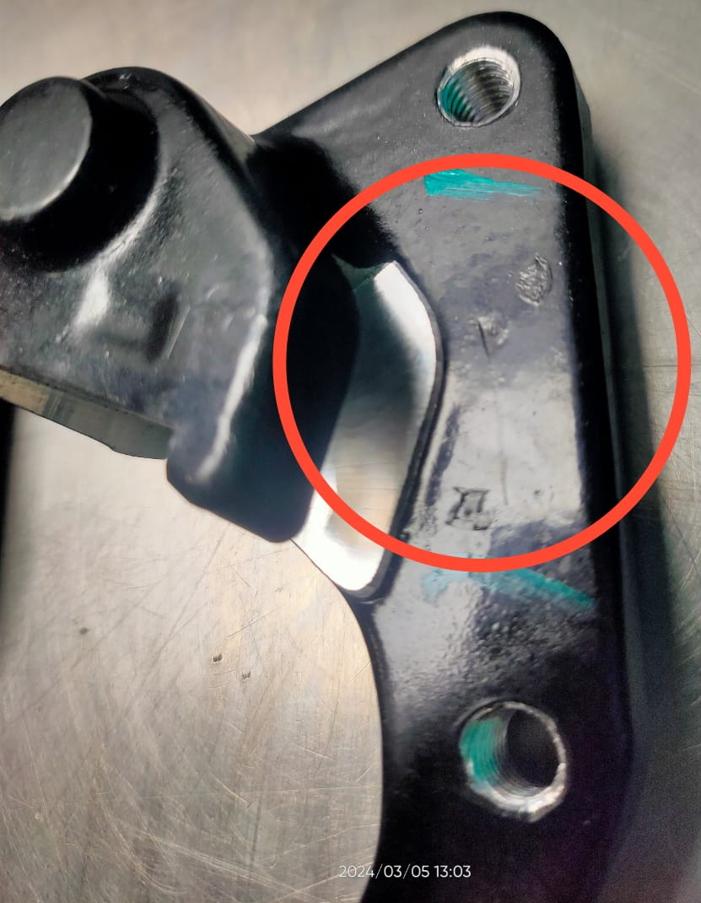
QSR Issues – Corrective actions
Part name & Part no. -Ather Front Holder Bkt Fin /B2FP09200O
Model- Customer complaint : powder coating Not Ok , orange pin holes dust & touch up.
Physical Phenomenon : powder coating Not Ok , orange pin holes dust & touch up.
powder coating Not Ok , orange pin holes dust & touch up.

Slide 2
Corrective Action Details
Before
After
During powder coating powder coating thickness was 120 to 150 microns
Casting shot blasting quality was poor Roughness value was 2-3 Ra
Casting roughness value is maintained from 5-6 Ra
Shot blasting time is increased from 3 minute to 5 minute.
Part Name | Model | Vendor | Defect | Actions | T. Date | Status
Ather front Holder Bkt Fin | Ather | Manoj Ind. | Customer complaint –powder coating Not Ok , orange pin holes dust & touch up. Physical Phenomenon powder coating Not Ok , orange pin holes dust & touch up. Why 1; powder coating Not Ok , orange pin holes dust & touch up. Why 2 : coating thickness increased from 120 – 150 microns Why 3 : surface finish is smooth ,Ra value observed 2-3Ra Why 4 : shotblasting was not done properly , Root Cause: shot blasting not done properly | Containment Action :- 1. .ETL End – 100% parts verified for powder coating defects. 2. . Available stock at Manoj Industries verified 100% for coating defects Inspection side action Supplier End:- Check point added at the Time FFPA Check point added in hourly in-process inspection sheet 100% part visually checked for coating defects in final inspection & green dot mark identification is provided Inspection side action ETL End:- 1- 100% visual inspection for powder coating defects. 2- Q Alert displayed at final inspection area. 3. Training provided to all concerned powder coating operators & Final inspectors. Cause Side Action:- casting shot blasting time increased from 3 minutes to 5 minutes to reduce coating defects. | 02.03.24 05.03.24 05.03.24 06.03.24 | Completed Completed Completed Completed Completed Completed Completed Completed
HORIZONTAL DEPLOYMENT : Ather Rear Holder Bkt
SUSTENANCE (PREVENTIVE) ACTIONS 3 Layer Audit , FFPA,
SYSTEM ACTIONS :-In process Inspection, Process Audit & Product Audit

Slide 3
Corrective Action Details
2
Before
After
Roughness value 2-3 Ra
Roughness value -5-6 Ra
Details of Actions decided
Shot blasting cycle time was 3 minutes earlier, Now Increased up to 5 minutes
Casting aesthetic defects ,roughness improved by Buffing the surface & then shot blasting done to achieve the required Ra value for powder coating.

