Slide 1
MAP ALLOYS

Slide 2
Blow hole action plan for B2FP05303O-HOLDER BRACKET CASTING -REML REAR J1C
Sr No | Part Name /No | Defect /Qty Rej | Why Why Analysis | Action Plan | Resp | Target Date | HD | Status
2. | REJ1c FRONT BRACKET | Blow hole – 234 Nos | Why 1- After machining blow hole observed at customer end . Why 2: Air interrupted at the time of Metal pouring. Why 3: Slits not provided to escape from die cavity. | Action Plan: 1.Slits provided in die t | 1.Mr. Dhande. | 1.20.01.2024 | Applicable for All Master cylinder Family | 1.Completed

Slide 3
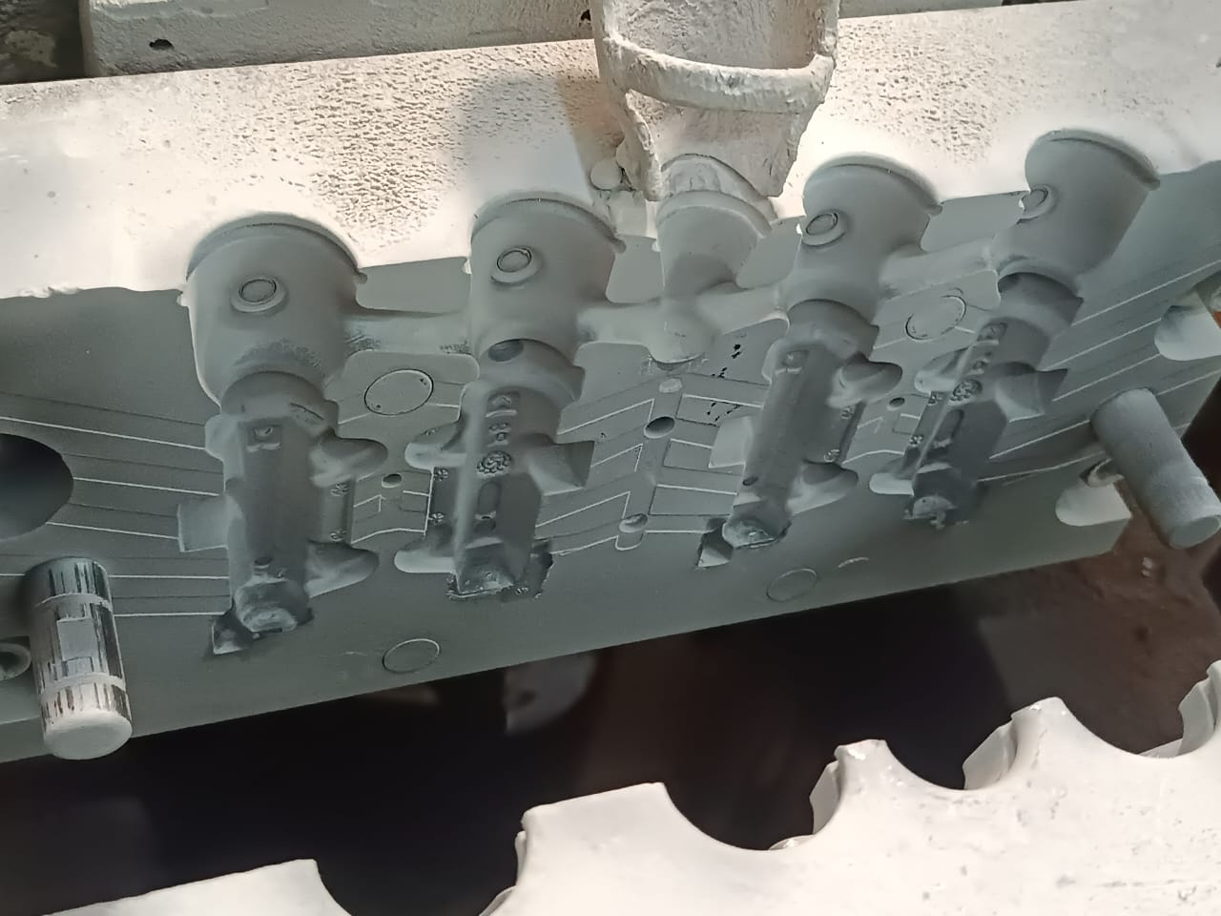
Before
After
Blow hole action plan for B2FP05303O-HOLDER BRACKET CASTING -REML REAR J1C
No
No slits provision in this Die to escape air from cavity of die .
Air slits provided in Die to escape air from cavity of die .

Slide 4
THANK YOU

