Slide 1
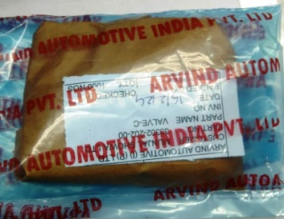
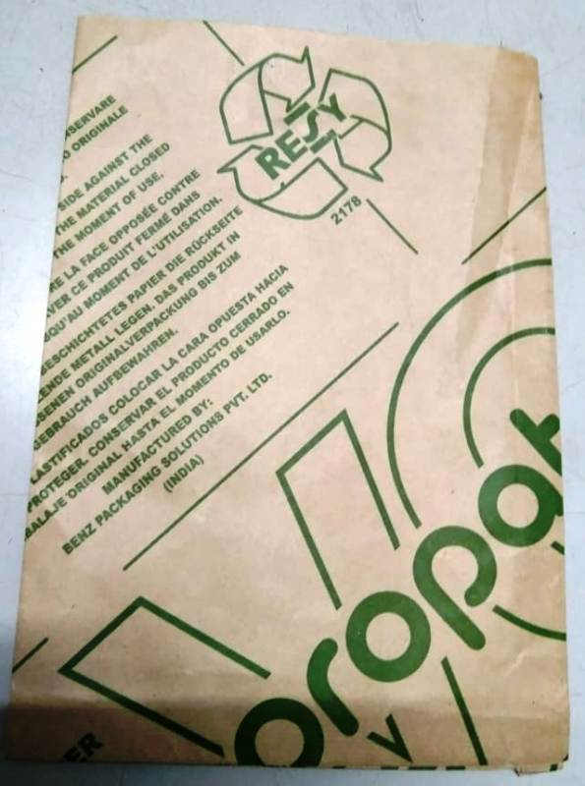
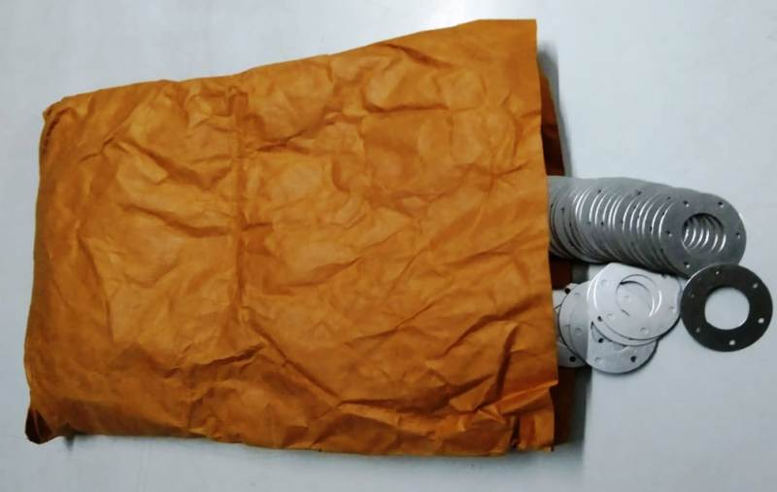
Rust Problem improvement
ARVIND AUTOMOTIVE
Target Date:-20/02/2024
Status:-Under process
Before
After
Previously VCI pouch quality using in shining condition and rust preventive time max 1 month
Now VCI pouch quality change .

