Slide 1
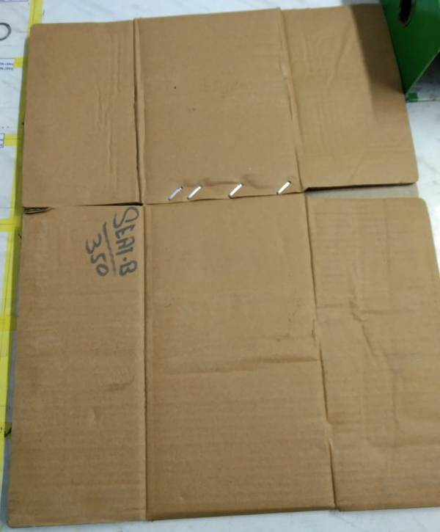
Rust Problem improvement
ARVIND AUTOMOTIVE
Target Date:-25/01/2024
Status:-Done
Before
After
Previously box paper quality not good and 3 ply available only
Now Corrugated Boxes paper quality change and 7 ply (layer) use for packing .

