Slide 1
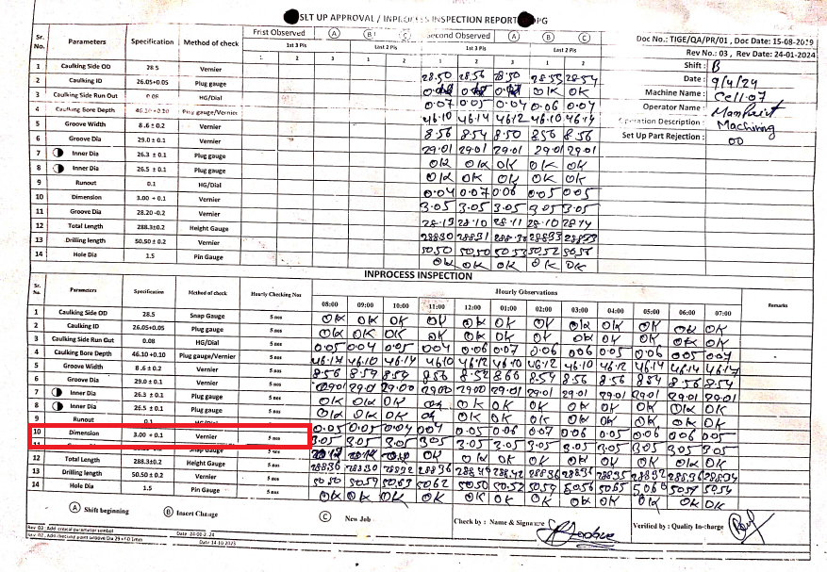
ACTION EVIDENCIES -
BEFORE :- Hourly inspection for Inspection with Vernier for Dim 3 mm.& NO range Define for Vernier Inspection

