Slide 1
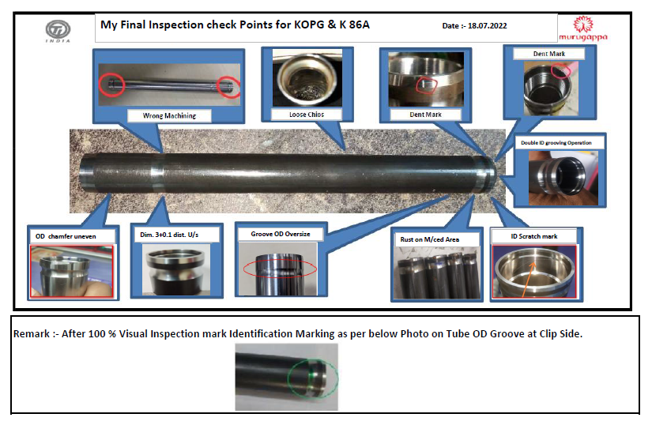
ACTION EVIDENCIES -
AFTER:- Inspection Point added in Final Inspection for Visual Inspection

Slide 2
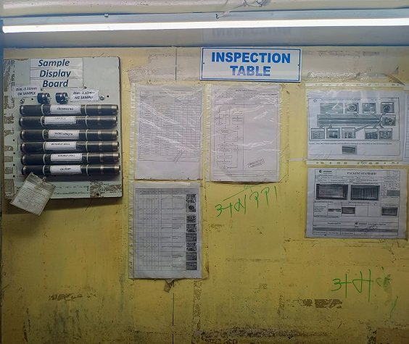
ACTION EVIDENCIES -
AFTER :- Inspection Point added in Final Inspection for Visual Inspection & Defect Samples Displayed

