Slide 1
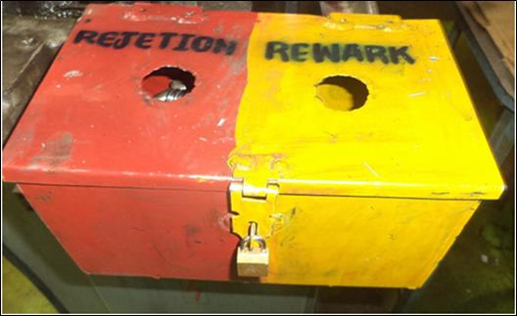
Countermeasure:- MACHINING STAGE
EVIDENSES
TRAUB OPERATION : SE/ALM/01
BEFORE
AFTER
1. Red bins available on machine need lock and key type.
Problem/Present Status:
Open red and yellow bin provided for setting/NG pieces.
Countermeasure:
Rejection & Rework material kept in lock & key on machine to avoid mix up issue.

