Slide 1
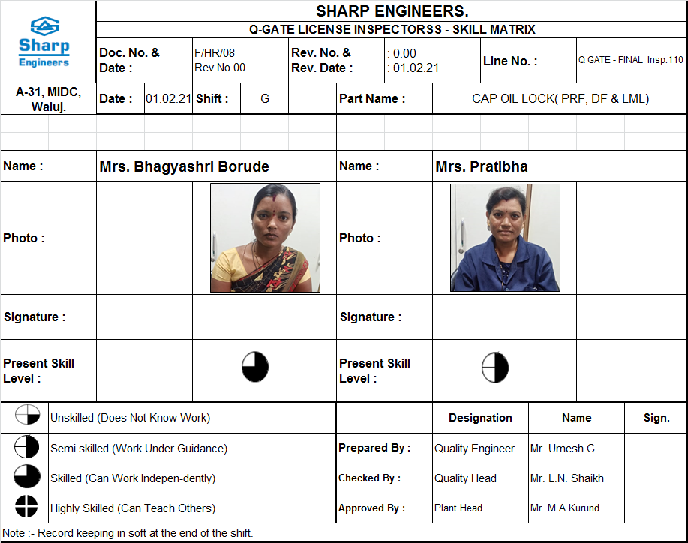
Countermeasure:- INSPECTION STAGE
EVIDENSES
FINAL INSPECTION: Q GATE LICENSE
BEFORE
AFTER
Problem/Present Status:
Stage wise skill matrix not evident.
Countermeasure:
Stage wise skill matrix monitoring and Q gate license implemented for inspectors. OPL displayed & on job training given.

