Slide 1
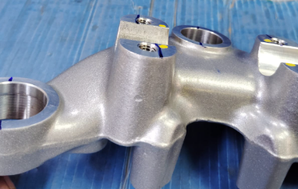
Part Should be ok for Dent & Damage

