Slide 1

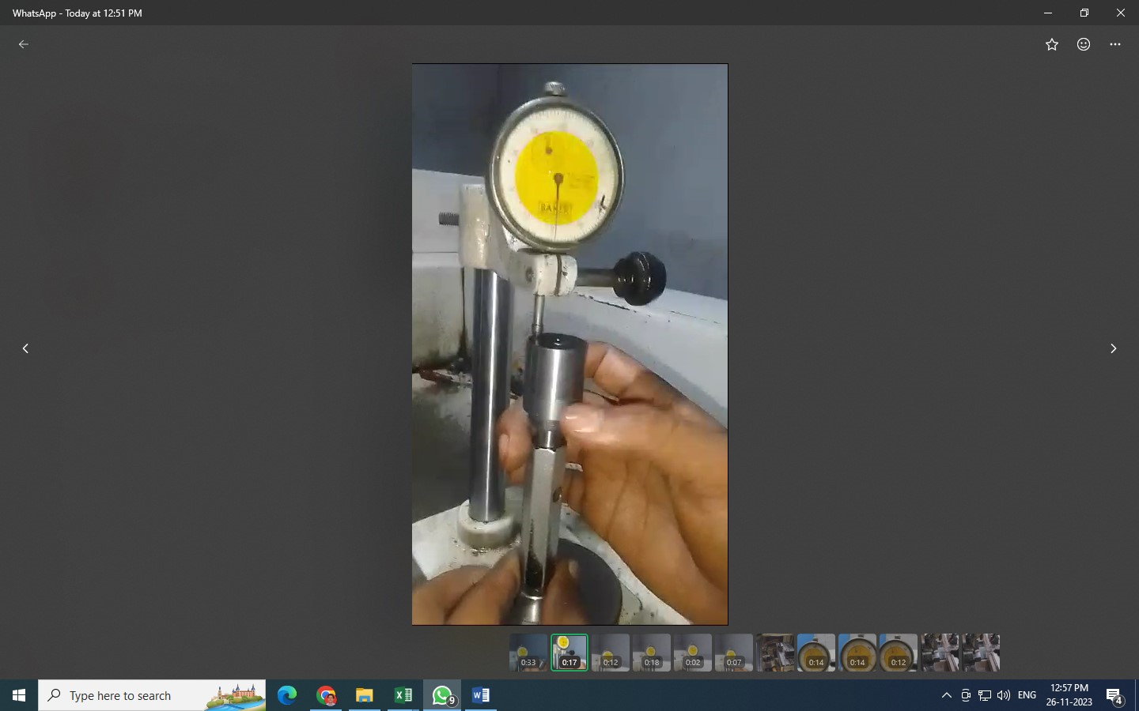
Detection Side Corrective Action
After
Dial Stand Provide on CNC machine for 100% parallelism speciation Inspection

