Slide 1
MAP ALLOYS

Slide 2
Blow hole action plan for B2FP05203O- REJ1C HOLDER BRACKET RAW
Sr No | Part Name /No | Defect /Qty Rej | Why Why Analysis | Action Plan | Resp | Target Date | HD | Status
2. | REJ1C HOLDER BRACKET RAW CASTING /B2FP05203O | Blow hole – 140 Nos | Why 1- After machining blow hole observed at customer end . Why 2: Air interrupted at the time of Metal pouring. Why 3: Slits not provided to escape from die cavity. | Action Plan: 1.Slits provided in die to escape the air from cavity . 2.Die PM check sheet updated. | 1.Mr. Dhande. | 1.10.04.2024 | Applicable for All bracket Family | 1.Completed

Slide 3
Blow hole action plan for B2FP05203O- REJ1C HOLDER BRACKET RAW
BEFORE
AFTER
No Slits provision in die to escape air from cavity of Die
Slits provided in die to escape air from cavity of Die
No Slits provision in die to escape air from cavity of Die
Slits provided in die to escape air from cavity of Die
Air slits provided in Die to escape air from cavity of die .

Slide 4
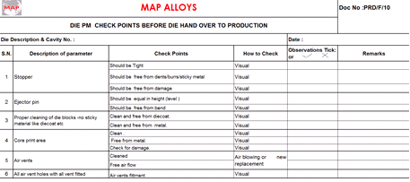
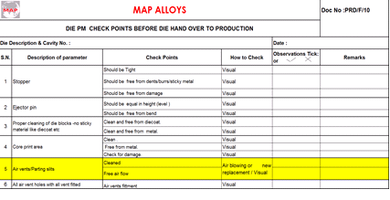
BEFORE
AFTER
Only air vents check point provided in die PM check sheet
Parting slits added in check point of die PM check sheet

Slide 5
THANK YOU

