Slide 1

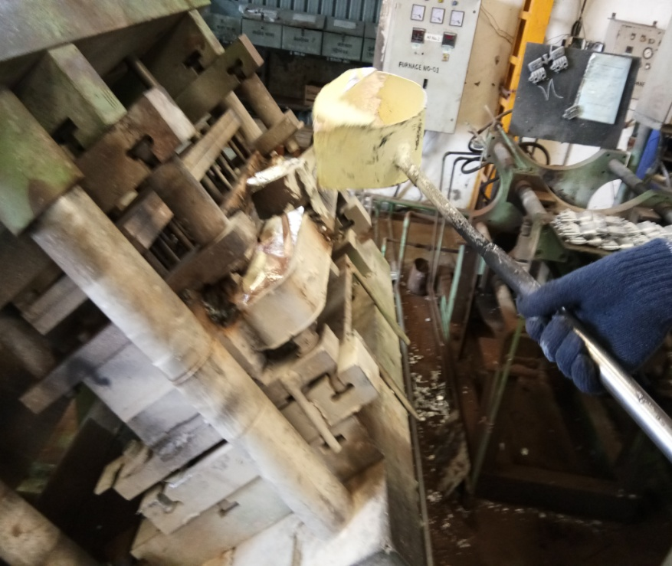
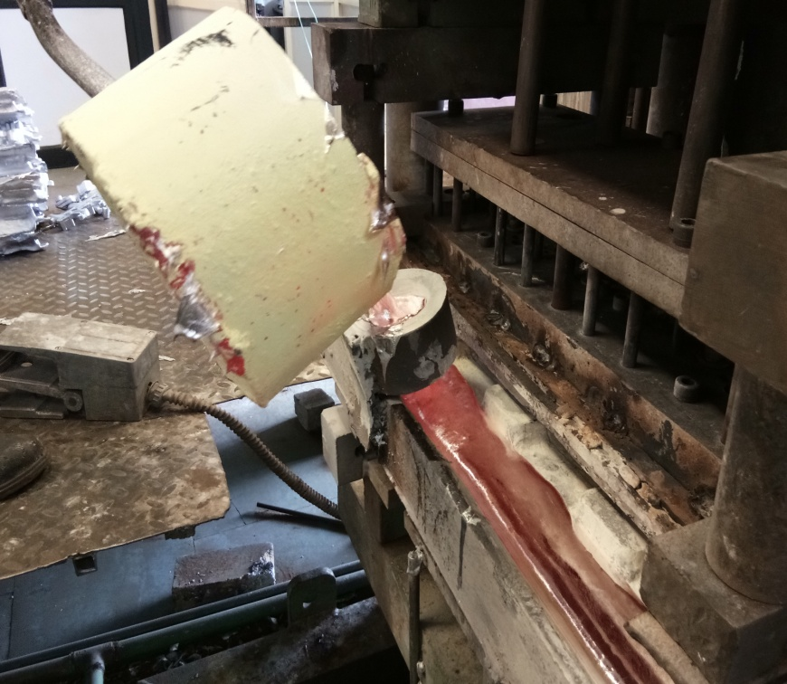
CORRECTIVE ACTION FOR BLOW HOLE
Root Cause : 1)Wrong Pouring Method .2) Fast metal pouring in tilting up condition.
Before (Wrong pouring)
After (Correct method)
Action Taken : 1 ) Use 16x16 wire mesh for metal pouring to avoid oxide content.
Action Taken : 2 ) Work instruction done for metal poring.

