Slide 1

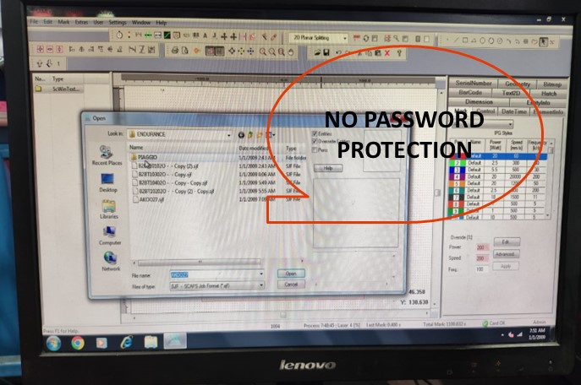
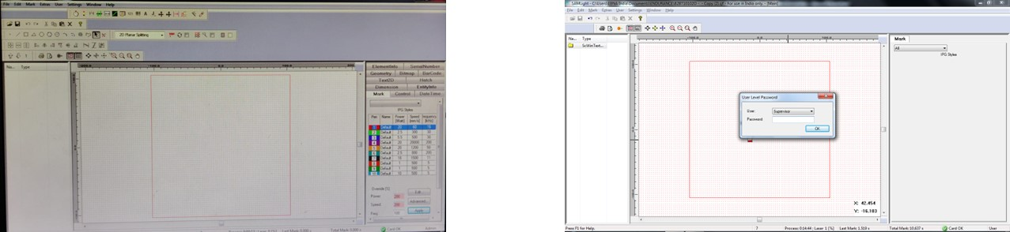
JAYASHREE TUBESTECH COMPONENT PVT LTD
@ copyright - JTCPL
Laser marking program
Before
After
No password protection for the file
Password protection implemented -Inprocess

