Slide 1
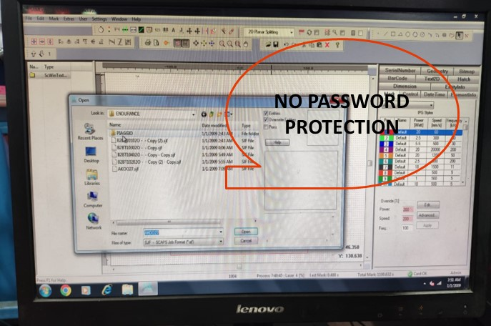
JAYASHREE TUBESTECH COMPONENT PVT LTD
@ copyright - JTCPL
Laser marking program
Before
No password protection for the file

