Slide 1
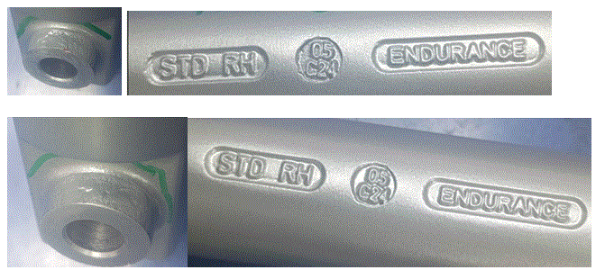
Q-Alert
Part Crack observed | 100% part check care fully for crack at identified area (Brake boss area)
Not OK
OK
Date-27.05.2024

