Slide 1
ENDURANCE TECHNOLOGIES
ACTION PLAN

Slide 2
OD oversize due to Hole burr mm

Slide 3
Action plan
Sr. No. | When | What |  | Which |  | Where | How many | Why | Corrective action |  |  | Who | When | Status
 |  |  |  | Part No | Part Name
 |  | Customer Complaint | Defect Phenomenon
1 | 22.03.24 | Fitment not possible due to burr | 3 mm hole drilling burr flow on shank | 52DD003260 | Bolt Banjo | ETL | 03 | Insp side: W1: Sampling inspection as per sampling plan Cause side: W1: Burr on OD from 3 mm hole W2: During drilling operation drill hole shift to lower side W3: Part not rest to the fixture plate W4- Part resting confirmation on fixture not available | Insp Side: 100% visual inspection and marking on part hex Cause side: Provide depth groove to the fixture to rest under head washer in the fixture |  |  | SCA Ganesh | 25.03.24 25.03.24 | C C
Sustenance action |  | Target date | Status | Preventive action |  | Tgt date | Status | System action | Tgt date | Status
QA Alert display |  | 25.03.2024 |  |  |  |  |  | Verification of bush and monitor the wear life | 30.03.2024 | C

Slide 4
Q ALERT
22.03.2024
OK
NOT OK
Hole ok
OD oversize due to Hole burr mm

Slide 5
Groove inspection by OD gauge

Slide 6
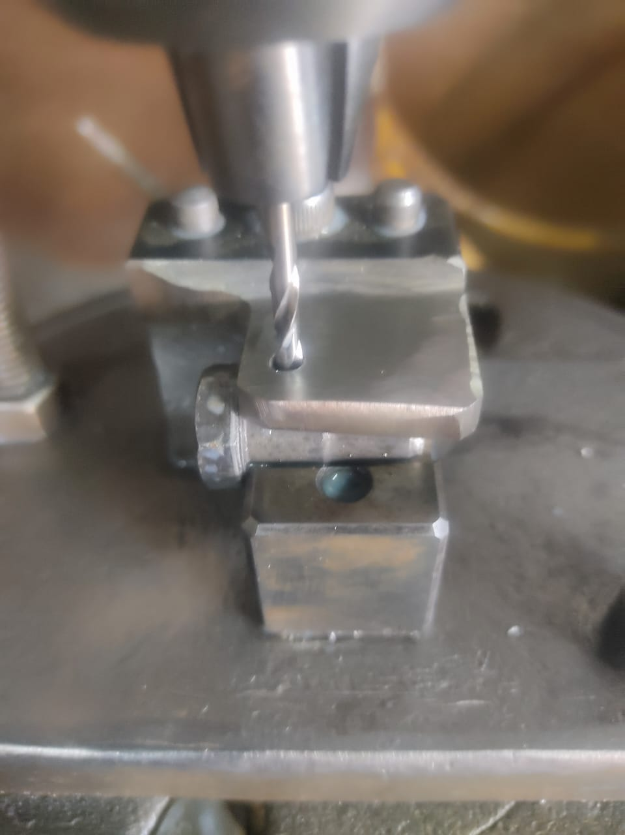
Provide depth groove to the fixture to rest under head washer I the fixture

Slide 7
Without thread and Nogo pass

Slide 8
Action plan
Sr. No. | When | What |  | Which |  | Where | How many | Why | Corrective action |  |  | Who | When | Status
 |  |  |  | Part No | Part Name
 |  | Customer Complaint | Defect Phenomenon
1 | 04.04.24 | Part found Nogo pass | Nogo pass | B2AG005260 | Anchor pin 8 mm | ETL | Under inspection | Insp side: W1: Sampling inspection as per sampling plan Cause side: W1: Nogo pass to the some parts W2: During thread rolling operations nogo Gauge pass W3: TRD at lower side 7.04-7.06 | Insp Side: 100 nos sampling per lot Cause side: Maintain TRD at higher side i.e 7.06-7.08 |  |  | SCA Ganesh | 05.04.24 05.04.24 | C C
Sustenance action |  | Target date | Status | Preventive action |  | Tgt date | Status | System action | Tgt date | Status
QA Alert display |  | 04.04.24 |  |  |  |  |  | Change the forging drawing Increase TRD | 05.04.24 | C

Slide 9
Action plan
Sr. No. | When | What |  | Which |  | Where | How many | Why | Corrective action |  |  | Who | When | Status
 |  |  |  | Part No | Part Name
 |  | Customer Complaint | Defect Phenomenon
1 | 05.04.24 | Part found without threads | Without thread parts mix up | B2AG005260 | Anchor pin 8 mm | ETL | 1 | Insp side: W1: Sampling inspection as per sampling plan Cause side: W1: Part found without threads W2: During thread rolling operations without thread parts mix up W3: Operators hold 5-6 pieces at input stage W4- During processing parts fallen down in out put box | Insp Side: 100% visual inspection and fix the lady inspector for this part Cause side: Give instruction to hold single piece during processing |  |  | SCA Ganesh | 05/04/24 05.04.24 | C C
Sustenance action |  | Target date | Status | Preventive action |  | Tgt date | Status | System action | Tgt date | Status
QA Alert display |  | 05.04.24 |  | Provide partition plate before out put box of thread rolling machine |  | 25.04.24 | IP | Point to be add in set up approval | 15.04.24 | IP

Slide 10
Q ALERT
22.03.2024
OK
NOT OK
OK PART
Without thread and Nogo pass

Slide 11
Extra material on middle in the thread issue

Slide 12
Action plan
Sr. No. | When | What |  | Which |  | Where | How many | Why | Corrective action |  |  | Who | When | Status
 |  |  |  | Part No | Part Name
 |  | Customer Complaint | Defect Phenomenon
1 | 12.04.24 | Extra material on middle in the thread issue | More plating | 520FK00102 | M5 Bolt | ETL | 10 | Insp side: W1: Sampling inspection as per sampling plan Cause side: W1: Extra material on middle in the thread issue W2: More plating deformation in threads W3: During plating process small parts stucked up in corners and trap points W4- Barrels trap points are open | Insp Side: 100% visual inspection and fix the lady inspector for this part Cause side: Close the trap points |  |  | SCA Jaikishan | 13/04/24 20.04.24 | C C
Sustenance action |  | Target date | Status | Preventive action |  | Tgt date | Status | System action | Tgt date | Status
QA Alert display |  | 12.04.24 |  | Trap point audit |  | 25.04.24 | IP

Slide 14
Action plan
Sr. No. | When | What |  | Which |  | Where | How many | Why | Corrective action |  |  | Who | When | Status
 |  |  |  | Part No | Part Name
 |  | Customer Complaint | Defect Phenomenon
1 | 12.04.24 | Extra cut on dia 8 mm | Other part mix up | B2BQ00826O | Brake lever screw | ETL | 20 | Insp side: W1: Sampling inspection as per sampling plan Cause side: W1: Extra cut on 8 mm diameter W2; During plating process 2 similar looking without groove and with groove parts mix up W3: Both parts plating processing 1 by one | Insp Side: 100% visual inspection and fix the lady inspector for this part Cause side: Make Alternate production planning for similar looking parts |  |  | SCA Jaikishan | 13/04/24 16.04.24 | C C
Sustenance action |  | Target date | Status | Preventive action |  | Tgt date | Status | System action | Tgt date | Status
QA Alert display |  | 05.04.24 |  |  |  |  |  | Plan alternate material receiving from machining | 16.04.24 | C

