Slide 1
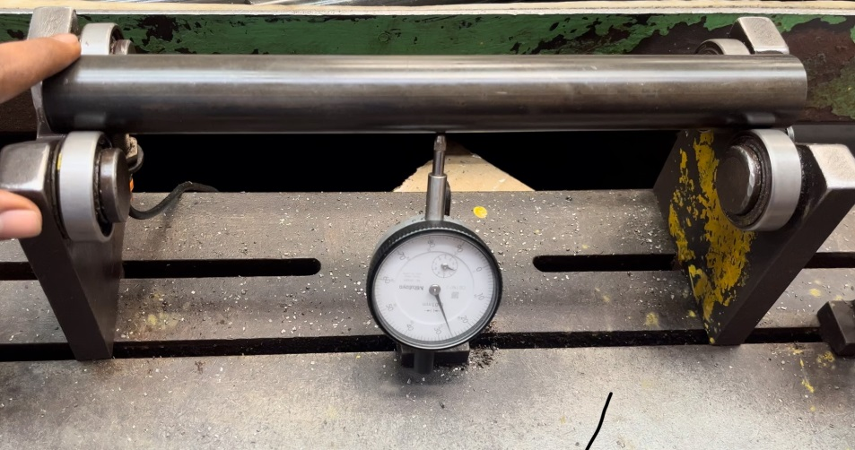
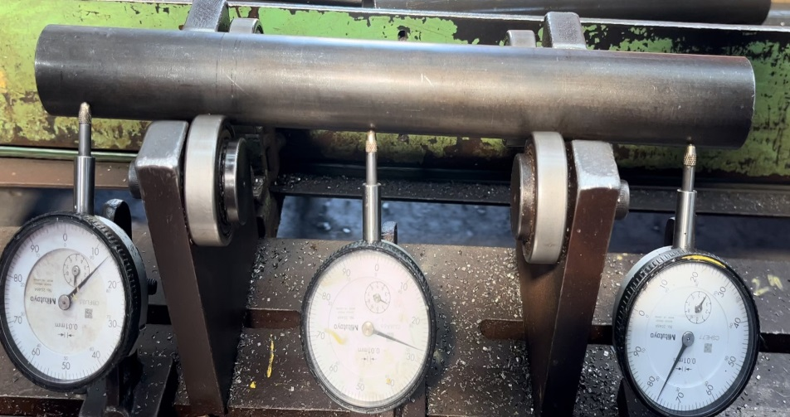
Inspection Side Before & After
Before
After
Inspection Method :- Dial indicator at middle
Inspection Location :- TFF CELL
Inspection Frequency at Each Location :- 100%
Other Details :- Nil
Inspection Method :- Three dial indicator , especially added one dial at both end of tube.
Inspection Location :- TFF CELL
Inspection Frequency at Each Location :- 100%
Other Details :- Nil

