Slide 1
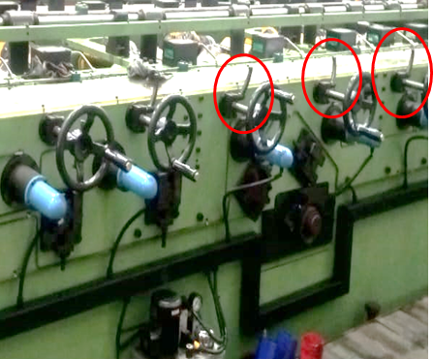
Occurrence Side Before & After
Before
Roll locking mechanism additionally provided outer side of roll adjustment handle.
After

