Slide 1
Action Plan Evidences
Fork Bolt RE-J1A –Threading Major Diameter Undersize

Slide 2
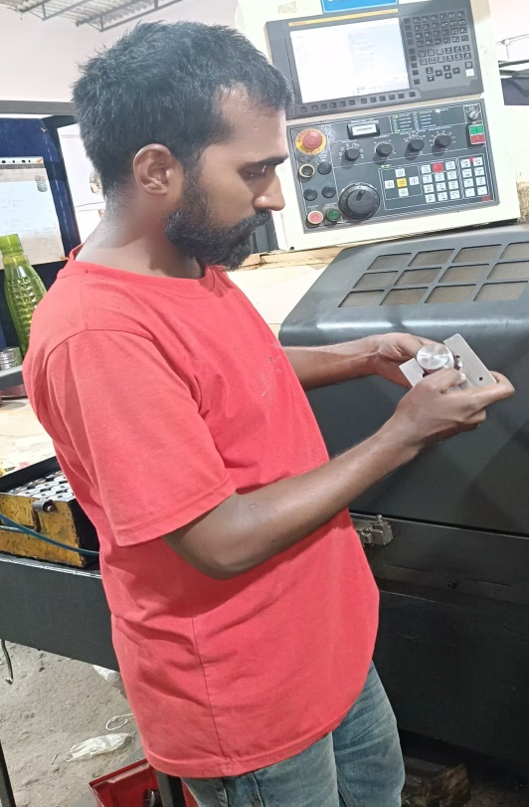
Action Plan Evidences
OUTFLOW - AFTER
100% Inspection of thread Major Diameter with Snap gauge of 37.68-37.75mm

Slide 3
Action Plan Evidences
OUTFLOW - AFTER
Q-Alert Displayed at final Inspection – at M/S. Shantasons
Inspection Standard Updated

