Slide 1
Action Plan Evidences
Fork Bolt 5TSF-Thread Washout

Slide 2
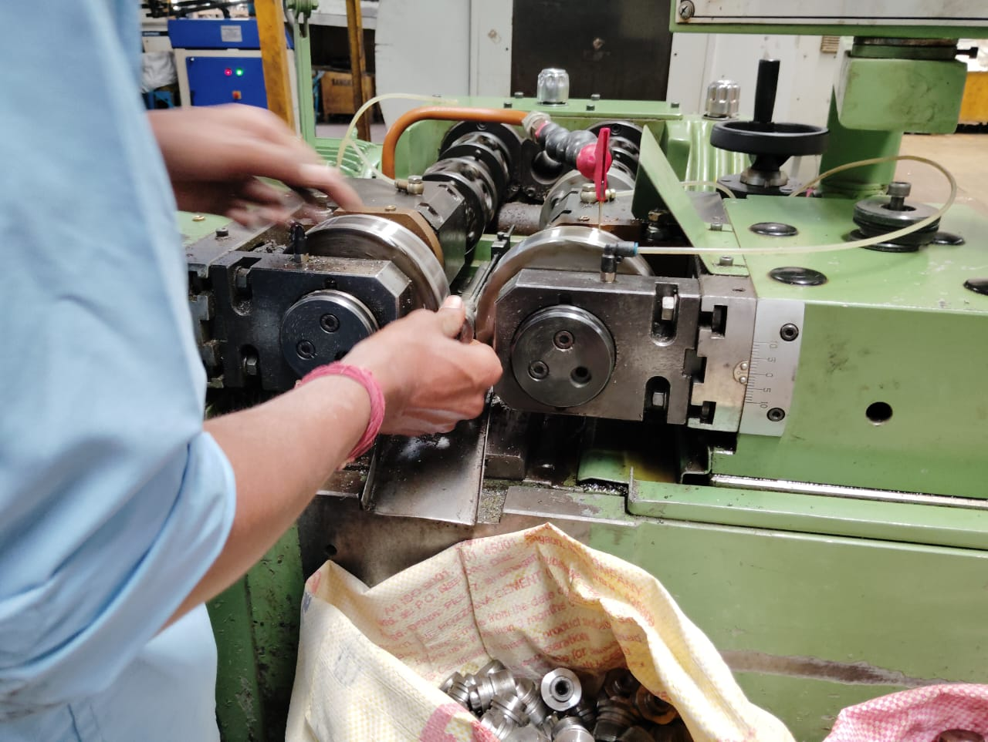
Action Plan Evidences
OCCURRENCE SIDE- BEFORE
While Setting, initial not OK Pieces are got Mixed with After setup OK parts.

Slide 3
Action Plan Evidences
OCCURRENCE SIDE- BEFORE
Work Instruction Rolling

