Slide 1
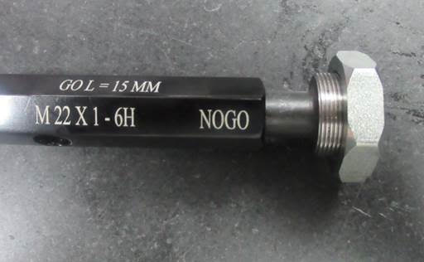
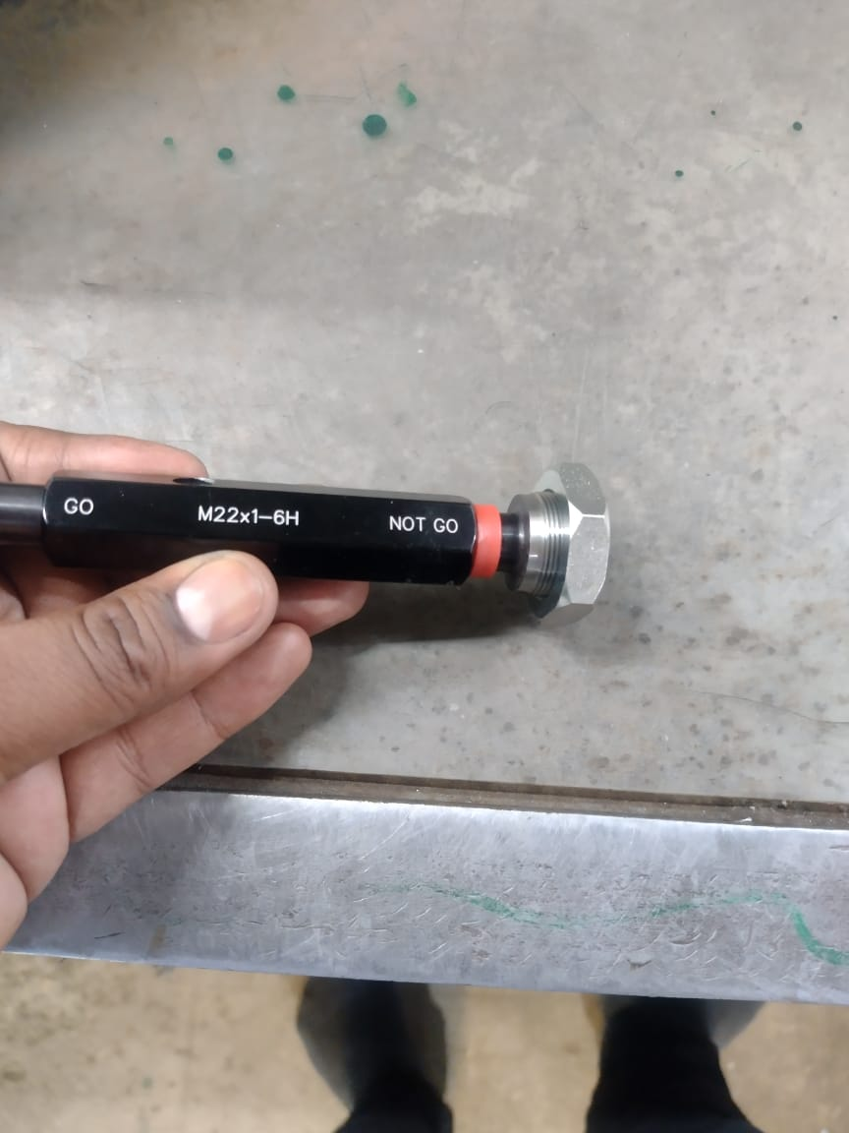
ONE POINT LESSON
Shop :- (SHARP ENGINEERS- G29) |  | Dept. :- FINAL INSPECTION (SE/FI-01)
Class |  |  |  | Lesson no | 01
 |  |  |  | Date of preparation | 11/01/2022
 | Basic knowledge | Improvement class | Trouble shooting class | Leader | Mr. Mohan Jadhav
 |  |  |  | Section leader | Mr. Chandan Tiwari
Topic:-M22 Thread NOGO pass
Key Points:- 100% check for TPG GO & NOGO, If observed NG keep the part separate in Rej. Bin
Know Why:- To supply defect free part at customer end.
OK
Not OK
Date | 29.04.2022 | 29.04.2022 | 30.04.2022 | 30.04.2022 | 30.04.2022
Teacher | Mr.Mohan J. | Mr. Chandan T. | Mr. Chandan T. | Mr. Chandan T. | Mr. Chandan T.
Learner | Mr. Chandan T. | Mrs. Gaikwad | Mrs. Jadhav | Mrs. Jayshri | Mr. Shaikh

