Slide 1
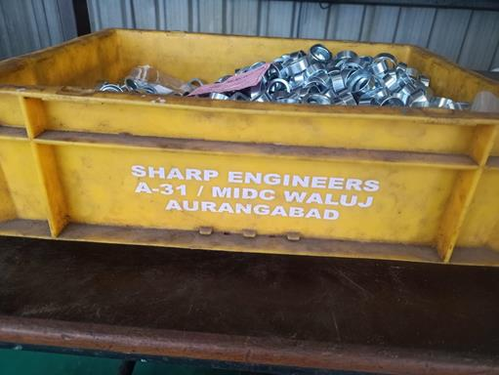
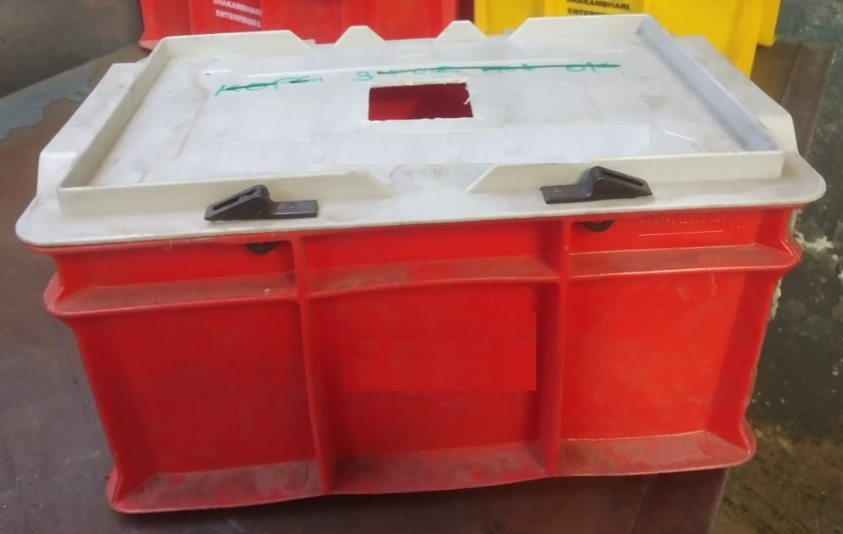
Countermeasure:- Machining stage
FINAL INSPECTION :- Q GATE Date: 30/05/2024
BEFORE
AFTER
Problem/Present Status:
Open bins for NG material for Valve retainer at final inspection and machining stage, parts getting mix up with ok
Countermeasure:
Red bins provided for NG material at final inspection and machining stage with key locking to avoid mix up issues.
Benefits :- NA

