Slide 1
Action Plan Evidences
Fork Bolt K-60 –Dimension 7.50mm undersize

Slide 2
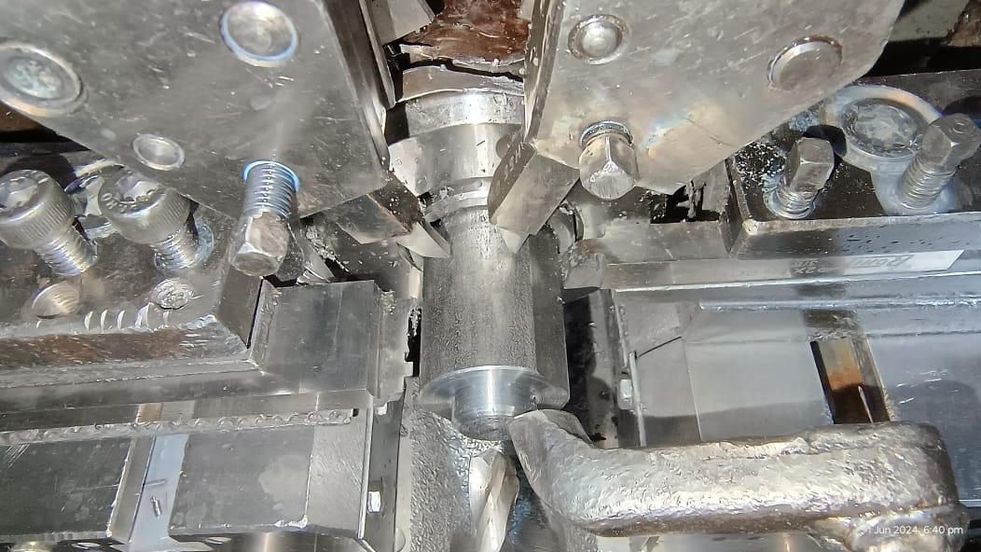
Action Plan Evidences
OCCURRENCE SIDE- BEFORE
Problem Analysis
Fork Bolt K-60, Machining is done on Traub Machine, where the Combination Wire cut Tool is used to finish the Dimensions below the Collar of Fork Bolt.
Wire Cut Tool

Slide 3
Action Plan Evidences
OCCURRENCE SIDE- BEFORE
1. Wire-cut Tool used for the Fork Bolt K-60 is similar to fork Bolt PRFH, Only Difference is 3.50mm Dimension.
2. Wire-cut Forming tool of fork bolts are not identified with their names
No any Identification on Tool

