Slide 1
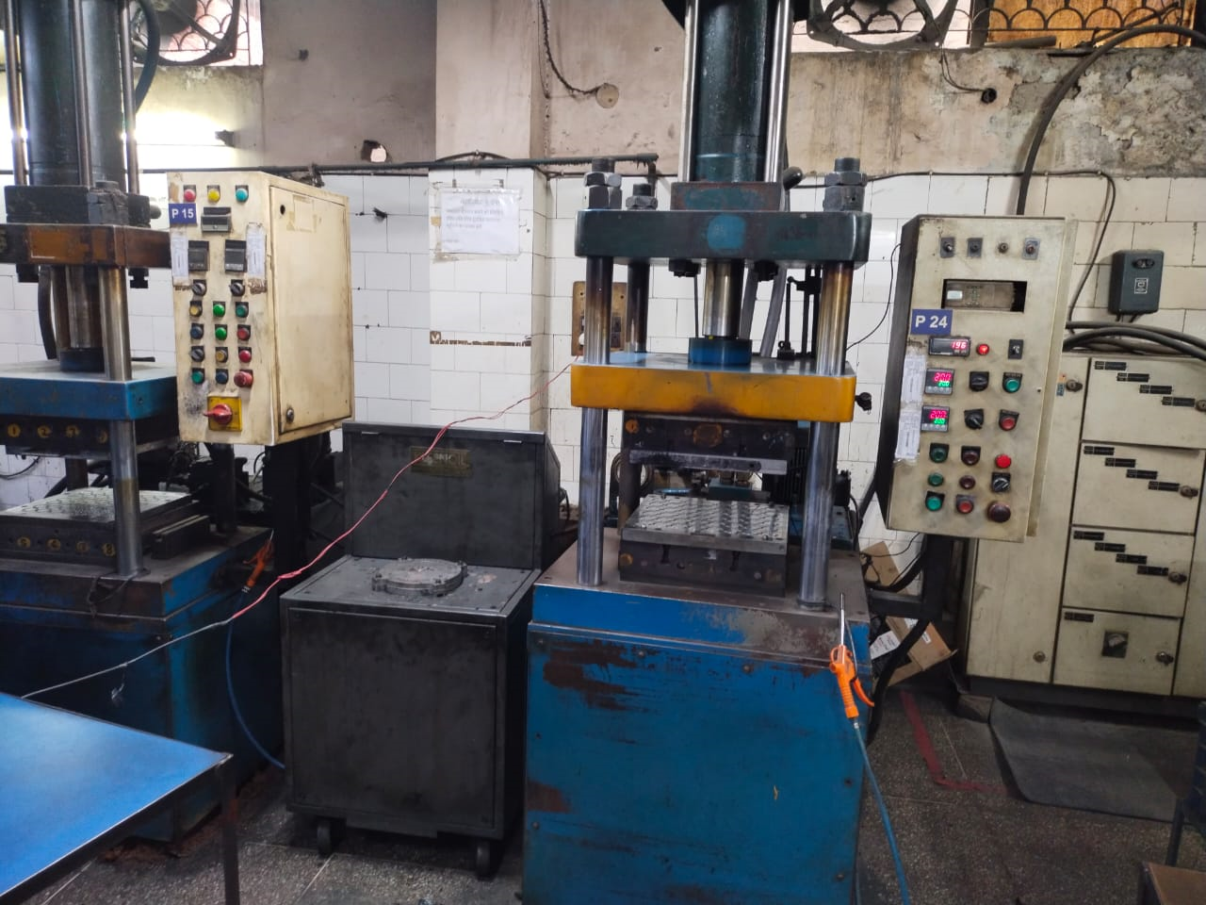
SUMMARY OF AUDIT OBSERVATION AND ACTION PLAN
OCCURANCE
Before
Machine no. P24 Endurance Part O Ring 550HH02302 running and Machine No. P15 Other Customer Part Running which were mixed. Both Machines are Semi Auto Machine.

Slide 2
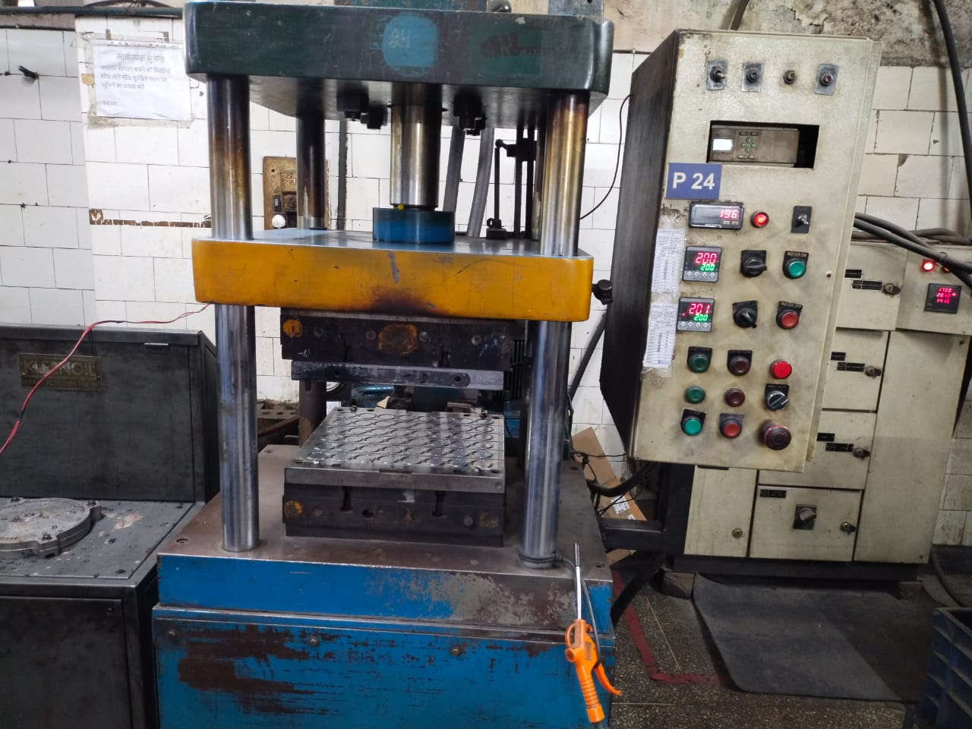
SUMMARY OF AUDIT OBSERVATION AND ACTION PLAN
OCCURANCE (AFTER)
After
The subject item has been shifted to the other plant of Kamal.
Machine no. P24 Fixed to Endurance Part O Ring 550HH02302.

