Slide 1
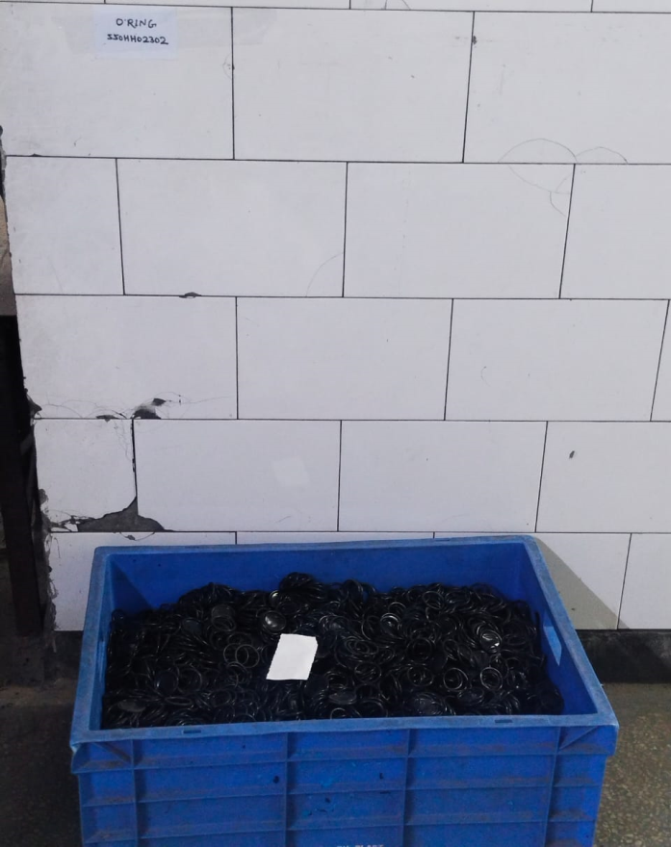
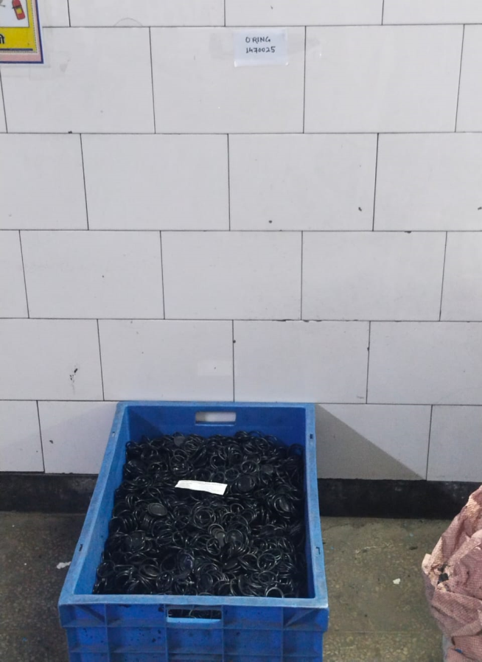
SUMMARY OF AUDIT OBSERVATION AND ACTION PLAN
OUT FLOW (Before / After)
Before
After
No separate area was define for All type of O Rings.
Separate area define for All type of O Rings.

