Slide 1
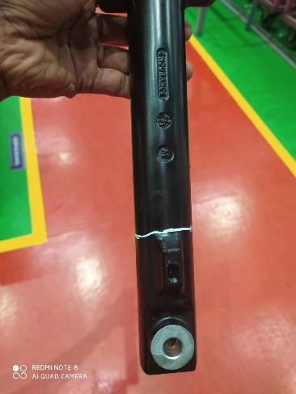
Q-ALERT
Not OK
OK
100% part check care fully for crack at identified Break boss area from Picture
Part Crack

