Slide 1
Part Name /No | Defect /Qty Rej | Why Why Analysis | Action Plan | Resp | Target Date | HD | Status
REJ1C Front Caliper/ B2BK04203O | Dent /Damage -342 Nos | Why 1: Dent Mark observed all around casting. Why 2: Part to part contact at fettling and gate cutting stage. Why 3:At gate cutting and Fettling area part stacking /accumulated method inadequate and improper handling . | Fettling area location changed and On job training provided to all fettling operator for material handling. . | Mr.P.D.patil | 15.06.2024 | Calipers family running in Auto machine like-K11 (Integral )caliper, Yamaha caliper, KHI caliper etc. | Completed

Slide 2
Dent /Damage action plan
Part Name /No | Defect /Qty Rej | Why Why Analysis | Action Plan | Resp | Target Date | HD | Status
REJ1C Front Caliper/ B2BK04203O | Dent /Damage -342 Nos | Why 1- Dent /Damage observed in REJ1C front Caliper at ETL. Why 2:-Casting to casting Contact at production stage . Why 3:Two shots of casting kept in one hanger of trolley . Why4:Wrong trolley design. | Action Plan: 1.One no. of new single shot hanging trolley made and monitoring started. | Mr.Mandape/ Mr. Rakesh kumar | 1.27.06.2024 | 1.Applicable for All Calipers /Bracket
1.Completed

Slide 3
Sr No | Part Name /No | Defect /Qty Rej | Why Why Analysis | Action Plan | Resp | Target Date | HD | Status
4. | Reml J1C Front Caliper/ B2BK04203O | Sand drop/Pin holes -388+153 Nos | Why 1:Sand drop /Pin holes all around casting. Why 2: sand falls into cavity during die closing after sand core fitment . Why 3: Bonding between sand particles not adequate. | 1. Sand core trial with coating conducted on TVS Front Casting. 2. New supplier resin coated sand trial conducted to reduce sand drop issue. . | 1.Mr.R.Pandey 2.Mr.P.D.Patil | 1.15.06.2024 2.18.06.2024 | calipers family running in Auto machine like(K11 caliper, Yamaha caliper, KHI caliper, all Caliper Family .) | 1.Completed. 2.Completed

Slide 4
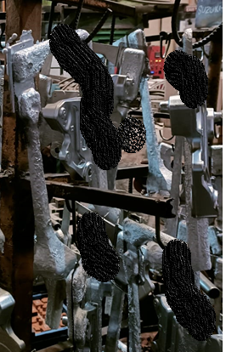
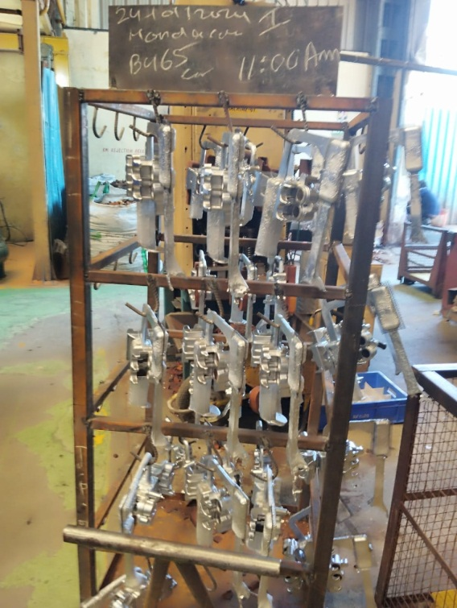
1.Casting hanging one trolley design modified ,awareness given to concern person and monitoring started.
Before
After
Material handling as well as material storage improve
One trolley modification done for casting hanging on line just after

Slide 5
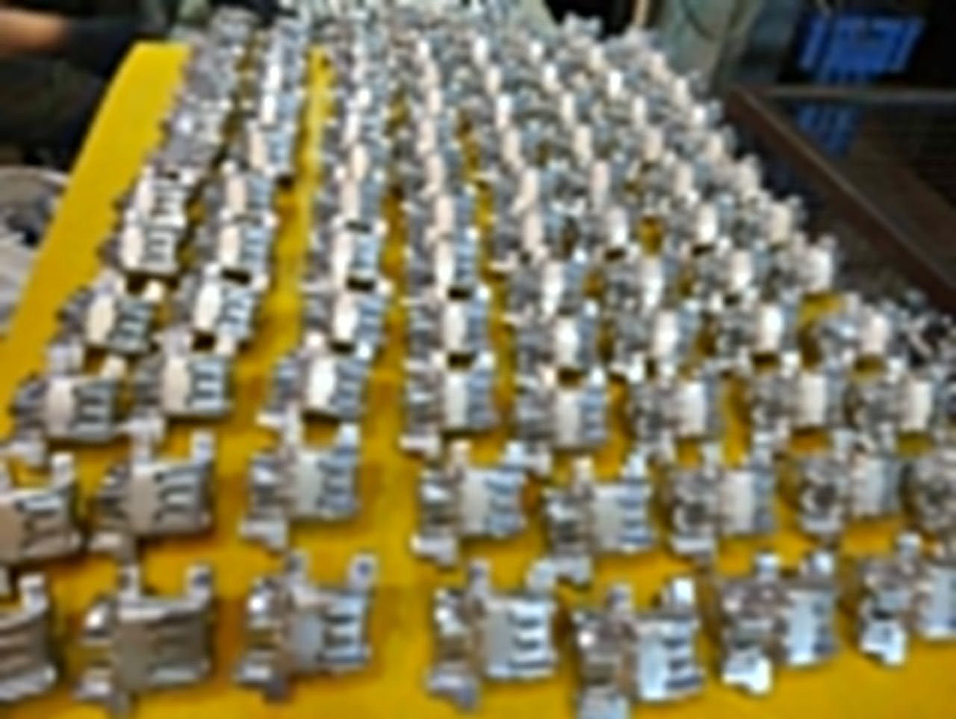
Caliper Family -Casting handling for Dent and Damage after on job training.
Before
After
Casting handling before on job training
Casting handling after on job training
Material handling as well as material storage improve at fettling area.

Slide 6
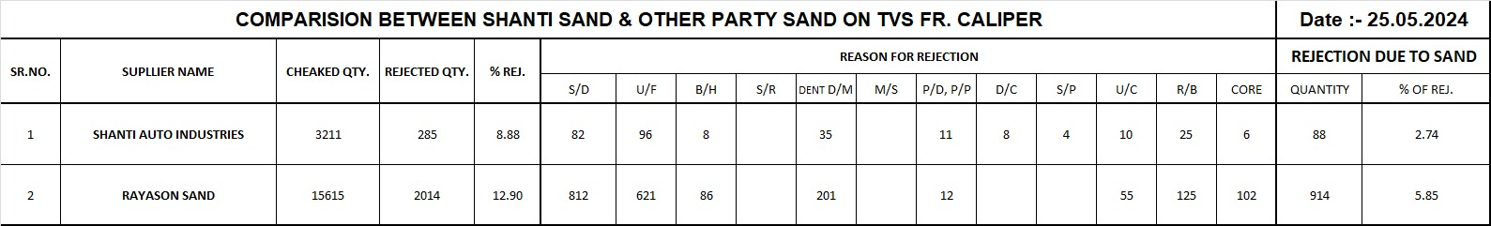
Shanti sand trial conducted to minimize sand drop and pin hole issues in Caliper Family.
Conclusion Shanti sand having less % of rejection than 3.1%

Slide 7
THANK YOU

