Slide 1
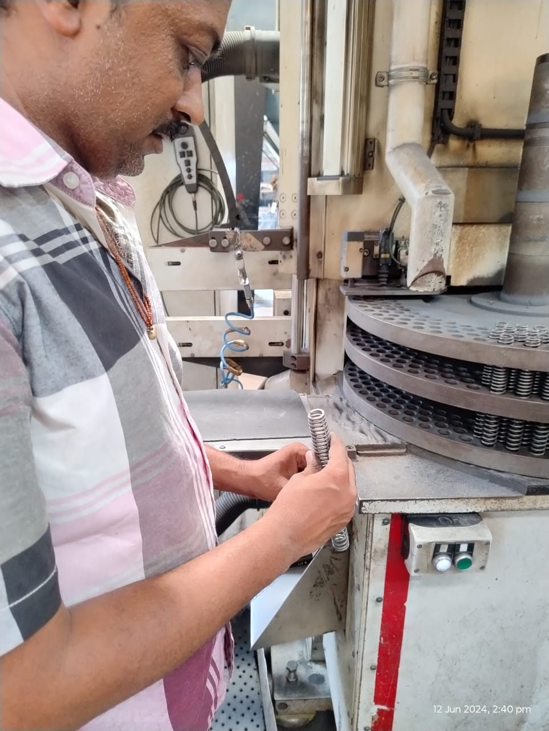
Sagar Springs Pvt Ltd
O.P.L (One Point Lesson)
Basic Knowledge: | Improvement Case: √ | Trouble Shooting Case:
OPL Theme: Checking the Grinding Angle | Lesson No: 63 | Date: 01.06.2024
Not O.K | O.K
Impact: * Sampling Inspection at Grinding stage | Corrective Action: * 100% Visual Inspection at Grinding stage

