Slide 1
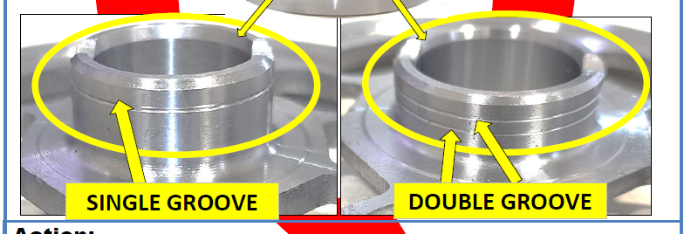
Single Groove GPH(AA101601)
OD | 121.90+0.02/-0.04
Double Groove GPH(AA101590)
OD | 121.75+0.02/-.0.04

