Slide 1
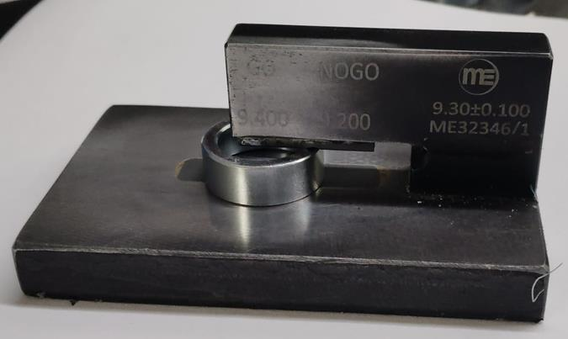
Countermeasure:- Inspection Techniques
EVIDENSES
FINAL INSPECTION: ‘Q’ GATE
BEFORE
AFTER
Part locating at one side only
Problem/Present Status:
Taper observed at one side of the parts, inspection done only one side of the part. Gauge design not proper , taper not detecting while inspection.
Countermeasure:

